Slide 1



Memory Tiering in Python Virtual Machine
VMIL ‘25
Yuze Li, Shunyu Yao, Jaiaid Mobin, Tianyu Zhan, M. Mustafa Rafique, Dimitrios Nikolopoulos, Kirshanthan Sundararajah, Ali R. Butt
Notes:
Hello I’m Yuze Li from Virginia Tech. Today I’m going to talk about our work on memory tiering in Python virtual machine. This is a joint work with collaborators from Virginia Tech and Rochester Institute of Technology. This work is partly funded by NSF.

Slide 2






Python
Python ranking 1st in programming communities in 2025^{[1]}
High memory cost:
Carries metadata for type and reference counting information
—-----------------------------------
uint64_t ob_refcnt;
struct typeobject *ob_type;
—-----------------------------------
… (others)
PyObject_HEAD
4 bytes
28 bytes
int
[1] TIOBE Index, www.tiobe.com/tiobe-index/
Notes:
Python is the world's most popular programming language. It’s simple and has power libraries.
[click]
But this simplicity comes with a hidden cost: it uses a lot of memory. Python VM maintains metadata such as object type and reference counting information.
[click]
A simple integer in Python can take up to 28 bytes while only 4 bytes in native languages like C/C++.
[click]
This makes the Python programs to use up a server’s memory more quickly.

Slide 3






Memory Tiering
small & fast
CPU
Local
DIMM
large & slow
Remote
CXL/PCIe
Latency
Memory cost
Goal: trace which data is hot and cold, and move them efficiently
Notes:
A typical way to solve this problem is through memory tiering. The idea is simple: you equip a server with two different types of memory.
[click]
First, you have a small but very fast tier, which is usually your local DRAM. Think of this as your desk space—limited, but everything is within arm's reach.
[click]
Then, you have a much larger, cheaper, but slower tier, enabled by new technologies like CXL. This is like your cabinet—massive storage, but it takes a moment to retrieve things.
The goal is to keep your frequently used, or "hot," data on your desk, and your less-used, "cold," data in the cabinet.
[click]
Essentially, we’re trying to achieve a better tradeoff between the application performance and the memory cost.
[click]
The goal here, of course, is to know exactly what's hot and what's cold at any given moment.
So, how is this problem typically solved today? There are two main approaches, and unfortunately, neither is a good fit for Python.

Slide 4
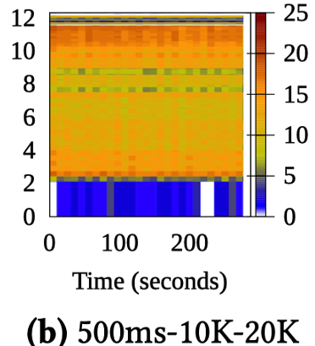
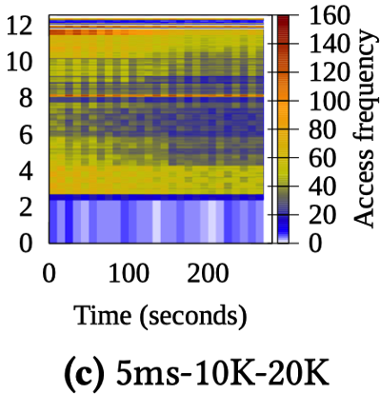

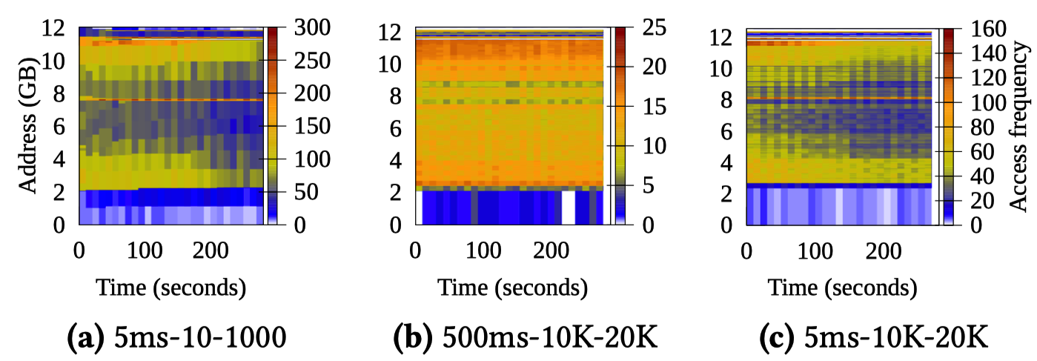
OS-level Tiering
One-policy-fits-all: OS sees all user-level applications equally. Impossible to make application-specific tiering adjustments.
  Latency sensitive VS. background tasks
Accuracy vs. Overhead
sampling interval ⬆️
Both accuracy lost!!
sampling granularity ⬇️
*Memtis: Efficient Memory Tiering with Dynamic Page Classification and Page Size Determination [SOSP ‘23]
Notes:
The first approach is managed by the OS. The OS watches which memory pages are being accessed and moves them between tiers. But it has two major flaws.
[click]
The 1st problem is one policy fits all: The OS treats all user level applications equally and applies one tiering rule to all applications.
However, this does not work well in today’s cloud, because different applications have different quality of service requirement.
[click]
For example, some jobs are latency sensitive, while some others are memory heavy but can are purely background tasks. It’s impossible for OS to make specific tiering configurations for different types of applications.
[click]
The 2nd problem is when the OS tracks page hotness, it needs to sample page access bits or relies on hardware counters. Hence, it comes with a trade-off between the sampling accuracy and overhead. It’s either introducing significant overhead that slows down application, or could be inaccurate, leading to poor decisions.
[click]
This set of figure shows that, if you increase the sampling interval or decrease the sampling granularity, although tracing overhead would drop, the accuracy is significantly lost. As you can see the boundary between hot and cold addresses are barely distinguishable.

Slide 5


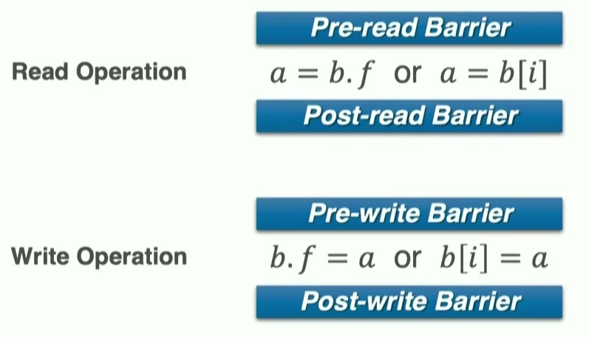
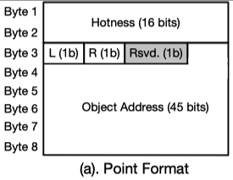
PL Runtime-level Tiering
Fine-grained object hotness tracing ✅
Make application-specific tiering configurations ✅
JVM-based
C++
Problem: CPython lacks the PL feature to track object hotness!
Notes:
The second tiering approach is to build tiering directly into a language's runtime.
[click]
These solutions are much more fine-grained that can track individual object hotness.
[click]
Plus, users can make application-specific tiering configurations.
This is a great idea, but the solutions that exist today are built for other languages.
[click]
In JVM-based runtime, you can instrument the read and write barriers to mark an object being accessed. Python doesn't have these barriers.
[click]
In C++, you can overload the smart points and the dereferencing operator to track every time an object is used. In the showing figure, the smart pointer uses the first 2 bytes as hotness tracker. When that pointer is dereferenced, the hotness indicator is incremented. However, the underlying implementation of Python is in C, which doesn’t support this..
[click]
Essentially, the fundamental problem is, Python lacks the PL feature to enable tracking object hotness, making it hard to build a memory tiering system.

Slide 6
Reference Counting
a
refcnt=1
PyObject
(logically freed)
PyObject
b
refcnt=2
Notes:
So, how did we solve this? We found a way to infer object hotness by using a feature that is central to Python's memory management: reference counting.
[click]
Python uses refcnt for garbage collection. It increases when a new name points to the memory object.
[click]
When all references to the object are removed,
[click]
the object is logically freed.

Slide 7
Reference Counting
c = a + b, assuming a = 10 and b = 20.
uint32_t ob_refcnt;
a.refcnt=1
a.refcnt=2
a.refcnt=1
b.refcnt=1
uint64_t ob_refcnt;
b.refcnt=2
b.refcnt=1
c.refcnt=1
uint32_t mtp_cnt;
c.refcnt=2
c.refcnt=1
↑ always increase
b=20
BINARY_ADD
a=10
c=30
Observation: although refcnt does not directly indicate object access, we can observe its changing behavior and infer their hotness.
Notes:
Let’s look an example of how Python evaluates a simple statement c = a + b. It does this by maintaining an operand stack. During evaluation, the objects’ refcnt are changed.
Initially we have variable a,b,c whose refcnt are all 1
[click]
First `a` is pushed into the stack, its refcnt is increments to 2
[click]
Same thing happens to name `b`, whose refcnt also increments to 2
[click]
Then `a` and `b` are popped from the stack, followed by an BINARY_ADD operation to add a and b
Note that `a` and `b`s refcnt drops to 1 after popping.
[click]
The evaluation result is stored to `c`. When pushing to the stack, it’s refcnt pops to 2.
[click]
Finally, after the statement evaluation is done, c’s refcnt drops back to 1.
Notice that although refcnt for all variables returns back to 1 after evaluation, they do get changed during the process.
[click]
Thus, our observation is, although refcnt does not directly indicate object accesses, we can observe its changing bahavior to infer the hotness.
Our system therefore uses this observation to track Python object hotness.
[click]
We do this by reusing the existing ob_refcnt field
[click]
The 32 LSB are left for original reference counting
[click]
We make use of the 32 MSBs to keep track of the refcnt changes.
[click]
However, unlike the original refcount, mtp_cnt only increases no matter the original refcnt increase or decrease.

Slide 8
Memory Tiering in Python VM (MTP)
Live objs set
Objs hotness metadata
Software-defined page table
pages
fast tier
Metadata
…
<page#, hotness>
slow tier
Sampling phases
Migration Plane
MTP tracing thread
Marking phase
needs to trigger marking
Hotness prediction
Eagerness-aware
Python API
MTP.start()
no
yes
Notes:
With that, we present MTP. MTP is a C extension module built atop CPython interpreter. Once enabled, it runs as a background CPython thread.
[click]
It first performs a marking phase to obtain all Python live objects.
[click]
Then it enters several consecutive sampling phases to obtain Python object reference count changing behavior. During the sampling, we periodically predict the sampled objects hotness using our inference model
[click]
After object hotness is obtained, MTP enters the migration plane for data promotion and demotion.
We use an eagerness-aware metric to calculate hot vs cold page threshold.
[click]
Because the marking phase temporarily blocks the application, we have to determine if the upcoming marking is really needed or not
I will know describe each component in detail.

Slide 9
Marking Phase
Problem: Python VM only tracks container objects in its 3 generational cyclic-GC lists
Solution: recursively mark all PyObjects starting from the cyclic-GC lists
Cyclic-GC list * 3
…
container object
non-iterable object
iterable object
…
Notes:
To start with, MTP needs to have the scope of all interested PyObjects. The internal Python virtual machine does maintain three generational GC lists to detect cyclic references, what is called as cyclic-GC lists.
Unfortunately, these lists only track container objects, for example, list, dict, tuple. If we only sample their hotness, a large number of objects will be ignored.
[click]
Thus, a marking phase is needed for MTP to obtain all PyObjects.
It works by recursively traverse all PyObjects starting from the cyclic-GC lists, like this.
Once facing an iterable object, it further traces to its children objects.
The marking finishes until all marked objects have no children left.

Slide 10
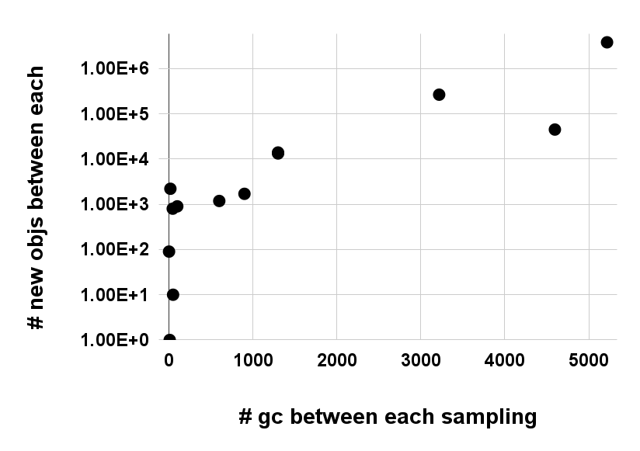
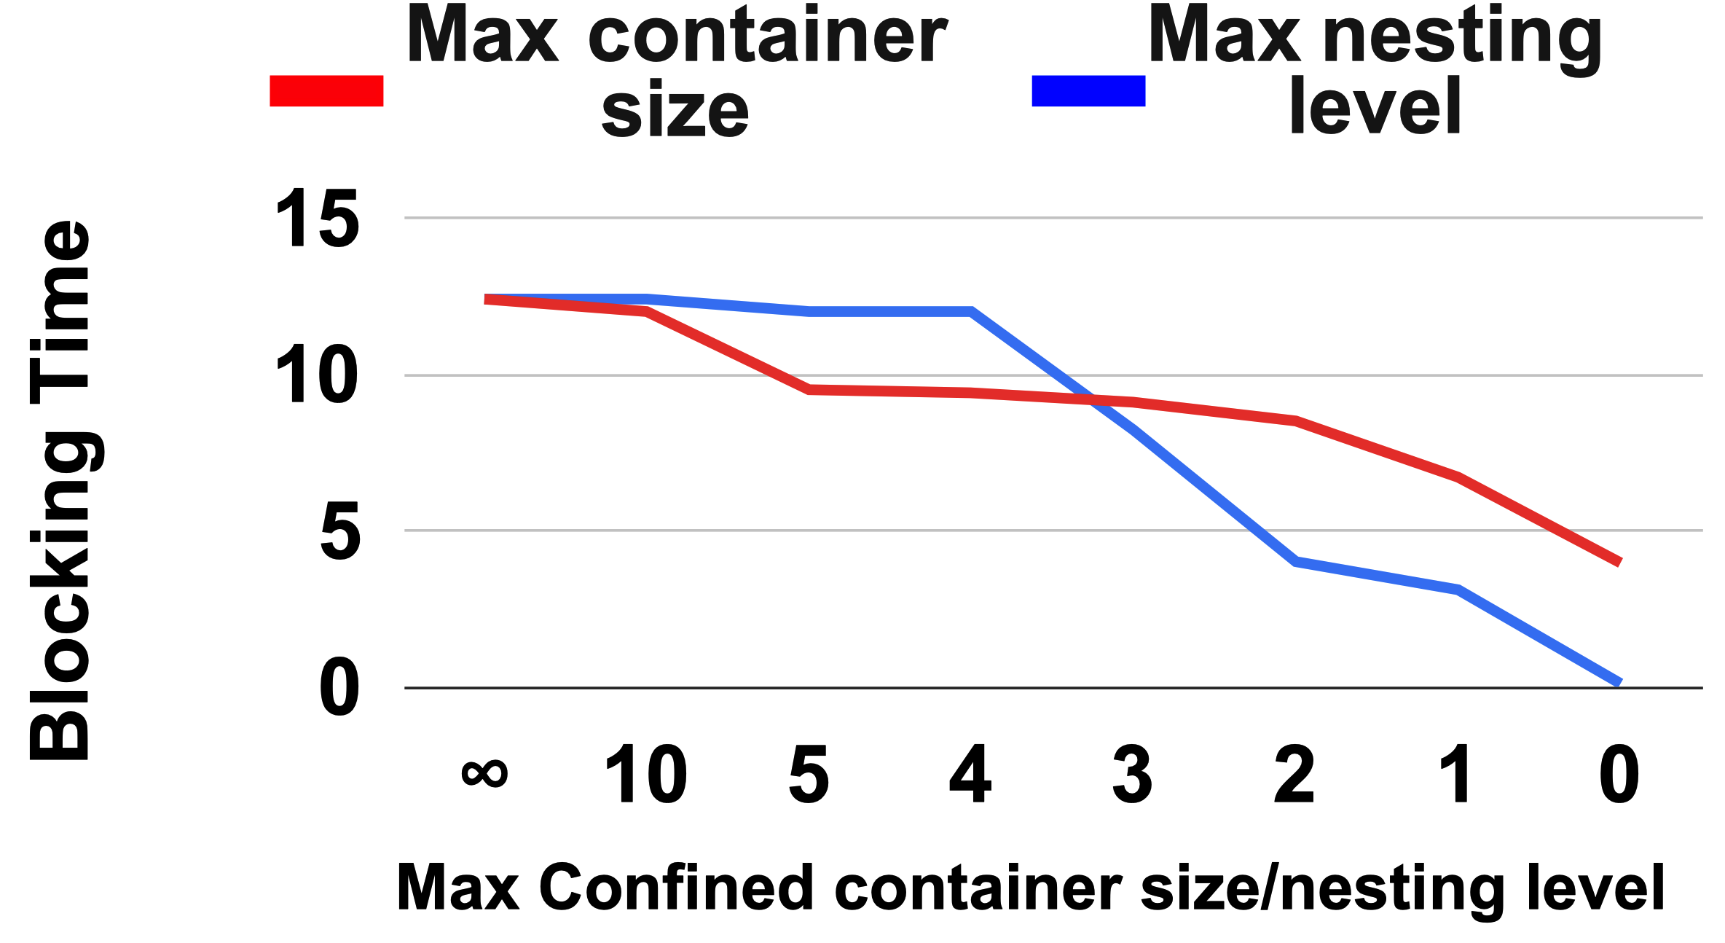
Marking Overhead
Problem: Stop-the-world
Solution 1: Reduce unnecessary # markings
Solution 2: Confine # objects for each marking
Notes:
However, the marking phase must be stop the world, which temporarily blocks the application. So we have to mitigate the overhead as much as possible but still maintain acceptable tracing accuracy.
[click]
Our first mitigation approach is trying to minimize # of calls to the marking phase.
Fortunately, this can be inferred by observing how CPython’s cyclic-GC behaves.
[click]
We observe that,
when only few cyclic-GC gets triggered, the number of new objects is also low, making it meaningless to initiate a new marking phase.
Based on that, MTP temporarily skips current marking phase when cyclic-GC activity is less intensive. While this may slightly reduce marking accuracy, missed objects will be detected in subsequent markings.
[click]
On the contrary, if we observe a lot of cyclic-GC happens between two consecutive markings, only then we would enforce a complete marking phase.
[click]
The second mitigation is to make sure that within one marking phase, the time taken would not be unbounded.
Thus, MTP tracks both the container size and nesting levels of the current container PyObject being traversed, and it will stop marking immediately when either of them exceeds a predefined threshold.
This figure shows how setting these two thresholds controls the trade-off between marking accuracy and overhead. The more aggressive MTP confines the threshold, the less blocking time it would take.

Slide 11
Sampling Phase
Objective: Infer hotness using refcnt changing behavior
Offline model training
Input features: median, standard deviation, count of non-zero refcnt changes, and range.
Ground truth: Page hotness from OS using DAMON^{[1]}
Model architectures: MLR, Polynomial, Random forest, MLP
[1] DAOS: Data access-aware operating system, HPDC ‘22
Notes:
Once MTP obtains the scope of all PyObjects, it enters several consecutive sampling phases.
Here we try to capture their refcnt changes and then use that information to infer the hotness.
[click]
So how do we train the model in offline?
[click]
We collected refcnt changing behavior from 20 workloads. Then we calculate statistics like median, stddev, number of non-zero refcnt changes, range and use them as input features.
[click]
To get the ground truth, we profile those workloads using DAMON, which samples OS pages hotnesses. And we align Python object addresses to the page boundaries, representing the hotness of those objects.
[click]
We choose several model architectures and fit the model with the above metrics.
Note that all of these are done offline only once.
//Once we get the fitted model, it should apply to all Python workloads because that’s the trained result of the interaction between refcnt and actual Python object hotness in Python VM.

Slide 12
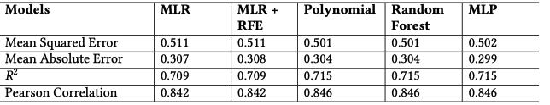

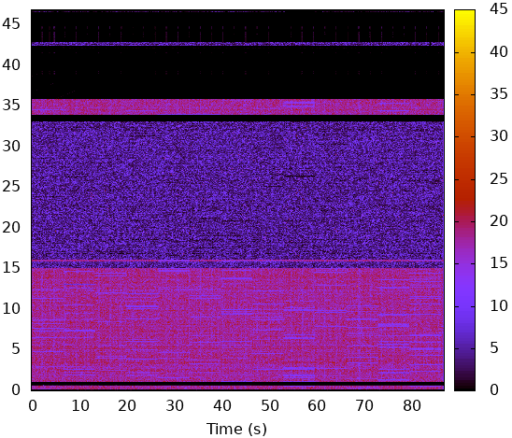
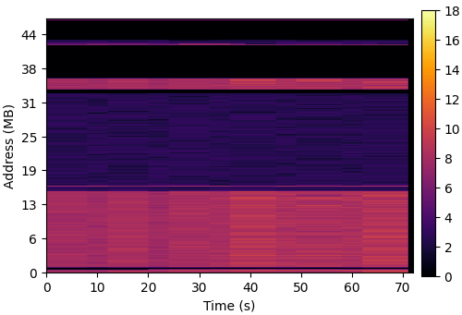
Hotness Prediction
Even simple MLR model can give decent prediction accuracy!
ground truth from OS
hotness prediction
Notes:
Here we show the performance of our hotness prediction model.
All models predicts the object hotness pretty well.
[click]
For example, multi linear regression, or MLR shows 0.7 of R^2 and achieves a Pearson correlation of 0.84, indicating a strong positive relationship with actual hotness.
[click]
Here’s a visualization of the hotness heatmap of a matrix multiplication workload from OS pages sampling.
[click]
On the right hand side, we show the visualized heatmap using our prediction model solely using refcnt changes. As you can see, it looks very similar to the OS ground truth.
This reveals that, MTP can accurately predict object hotness within Python VM, without sampling OS pages information.

Slide 13
Page Migration - Bucketing
Cold, should be demoted
Hot, should be promoted
3
Insert
4
10
# pages
3
hotness
Objects hotness in a page
Page hotness
Page hotness histogram
Notes:
MTP triggers the migration plane to move objects between tiers.
[click]
MTP aggregates all objects’ hotness inside that page.
For instance, a page with three objects of hotnesses 3, 4, and 3 has a total hotness of 10.
[click]
We maintain the page hotness information using a hotness histogram. All pages within a bucket in that histogram has the hotness values belonging to a range.
This is a standard practice for OS-based tiering solution.

Slide 14
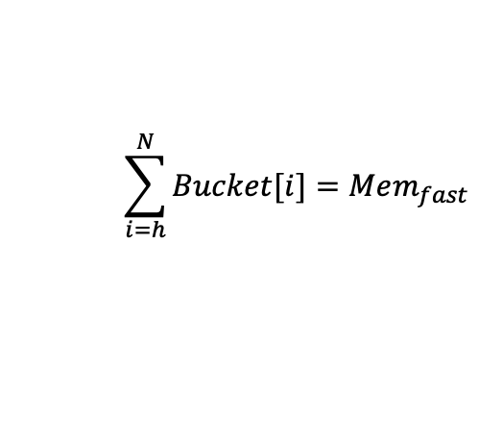
Threshold Determination
Problem: How to determine the bucket threshold between cold and hot?
Why challenging in MTP?
OS-based solution: sees all system physical pages. # hot pages ≈ fast tier capacity
how hot is hot?
$$\sum_{i=h}^{N}{Bucket[i]}=Mem_{fast}$$
h: threshold we want
N: Total # buckets
# pages
MTP: Only sees the virtual pages of this program
hotness
Page hotness histogram
Notes:
Once our hotness histogram is populated, MTP needs to decide the bucket threshold between cold vs. hot.
[click]
Determining this threshold is relatively easy for OS-based tiering solution. Normally, the total size of the pages in bucket h and above is just below the fast memory capacity. This is because OS tiering solution can see all system physical pages activities.
[click]
However, integrating the exact scheme into MTP is infeasible. Because MTP doesn’t have the global view of ALL system pages, so using the fast tier capacity to set this threshold makes no sense.

Slide 15
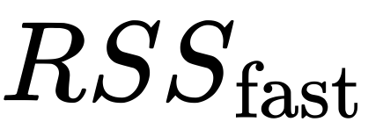
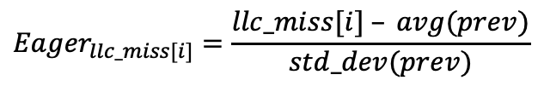



Threshold Determination
Eagerness: How eager pages are to be promoted from cold to fast tier
Most eager threshold h
$${Eager}_{total[i]}$$
=
*
$${Eager}_{llc_miss[i]}$$
*
$${Eager}_{bw_slow [i]}$$
# pages
Hotness
$${Eager}_{llc_miss[i]}=\frac{llc_miss[i] – avg(prev)}{std_dev(prev)}$$
Notes:
To accurately determine the hot/cold page threshold within a program, we introduce a new concept called eagerness.
[click]
Here i represents a time internal
[click]
We consider 3 factors:
the percentage of pages currently located in the fast tier
[click]
eagerness of last level cache misses
[click]
and eagerness of bandwidth going to the slow tier.
[click]
Eager llc_miss is basically the z-score of pages encountering LLC load misses. A higher eagerness value indicates more fluctuations current system deviates from the previous values. Eagerness bandwidth is calculated similarly.

Slide 16
Threshold Determination
h
h
h
Initial h (most eager)
# pages
Hotness
# colder pages in fast tier
# hotter pages in slow tier
①
>
②
if Eagerness ↓, move h ←
Notes:
MTP uses this information to iterate through the histogram buckets. Starting from index zero and moving right, one step at a time
[click * 3]
until it finds a bucket index ℎ where the number of colder pages in the fast tier (needing demotion) just exceeds the number of hotter pages in the slow tier (needing promotion).
[click]
This initial ℎ is considered the most eager threshold.
[click]
If we see a decreasing of eagerness value, this means that the current hot pages are less eager for promotion compared to the previous cycles. Thus, the threshold h is moved left by one bucket.

Slide 17
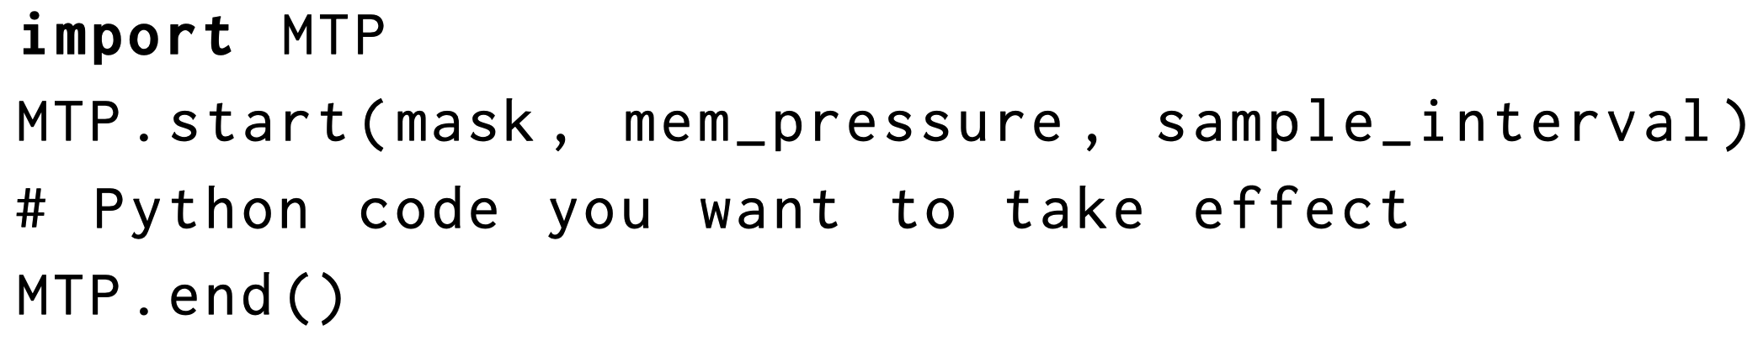


Interface
Per program, per code segment tiering control
Job types | mem_pressure | sample_interval
latency-sensitive | high | medium
background long running | low | high
Opportunity to be integrated to cloud orchestrators
Notes:
This code snippet shows how to use MTP.
[click]
Once imported, MTP.start() starts monitoring current fast-tier memory size.
[click]
When it falls below mem_pressure, the marking phase will then start.
[click]
The mask parameter indicates the memory node mask for demoting cold data
[click]
The sample_interval controls the interval for sampling phases.
[click]
Finally, MTP.end() stops the MTP thread and frees all metadata.
[click]
As you can see this simple API enables per Python program, per code segment tiering control
[click]
To use it, cloud providers can integrate MTP into Python instances with this API to control the tiering behavior for different workloads easily.
[click]
For latency-sensitive jobs (for example, web applications): you may want to set high mem_pressure and medium sample_interval to reduce MTP marking overhead and reduce remote access latency.
For long-running background tasks (for example, batch processing): you may want to use low mem_pressure and high sample_interval to maintain acceptable performance without impacting high-priority tasks.

Slide 18





Methodology
AutoNUMA
TPP (ASPLOS ‘23)
MEMTIS (SOSP ‘23)
Local
Remote CXL
25, 50, 75% *RSS
OS reserved
Notes:
We now show the MTP’s performance.
[click]
We use a machine equipped with two CPU sockets, CPU 0 and CPU 1, to simulate a CXL-powered tiering system.
[click]
And we disable all cores on CPU 1, so only CPU 0 can access data on both memory nodes.
[click]
We let the OS pre-consume some memory on memory node 0,
[click]
letting the same CPU socket to access the rest of the memory, we regard this as local fast tier.
[click]
To see the impact of different fast tier size towards performance, we deliberately set the application usable memory size to 25, 50, and 75% of the total application memory footprint respectively.
[click]
Memory node 1 is left on touched. Accessing this memory node from CPU 0 would be slow, hence, we use that as slow tier, or CXL.
[click]
On this system setup, we evaluate several graph and database workloads, invoked from popular python libraries NetworkX, and SQLAlchemy, respectively.
[click]
For our baselines, we chose three OS-based tiering solutions AutoNUMA, TPP and MEMTIS, all of which either samples page access bits, or relies on hardware counters.

Slide 19
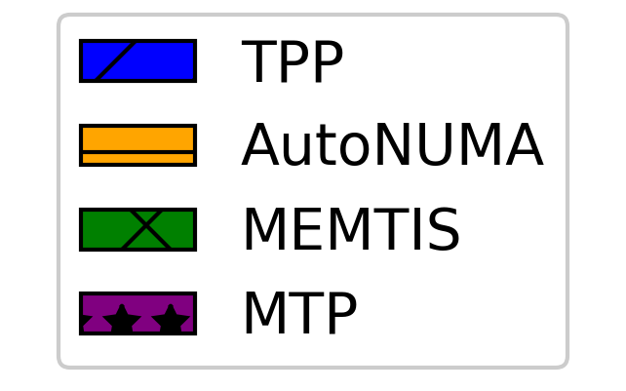
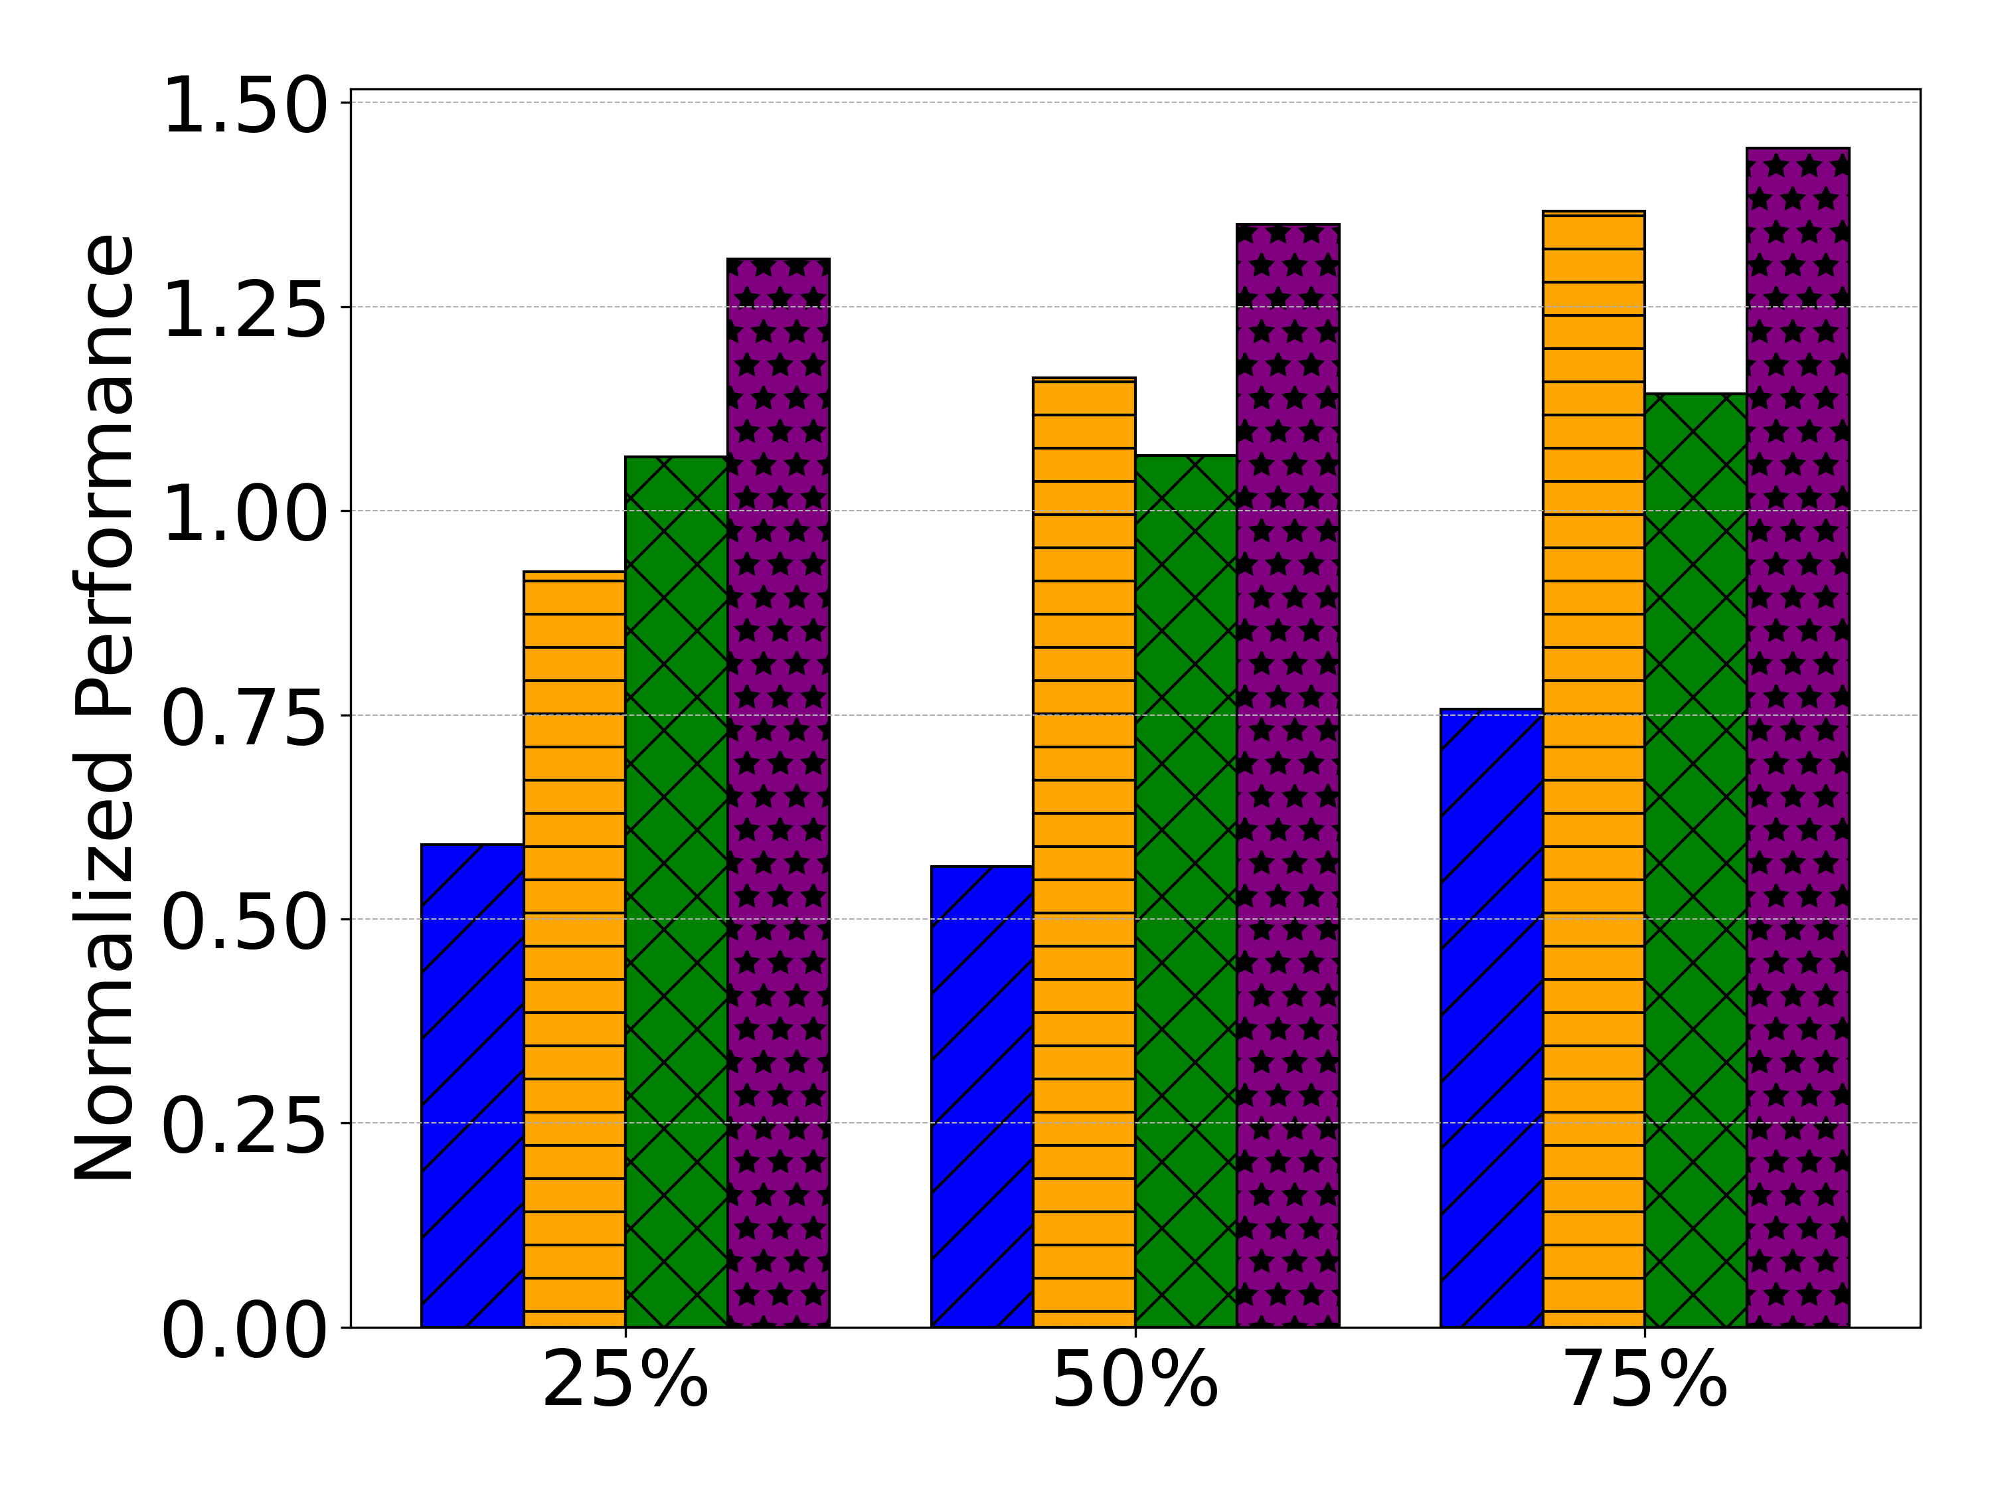
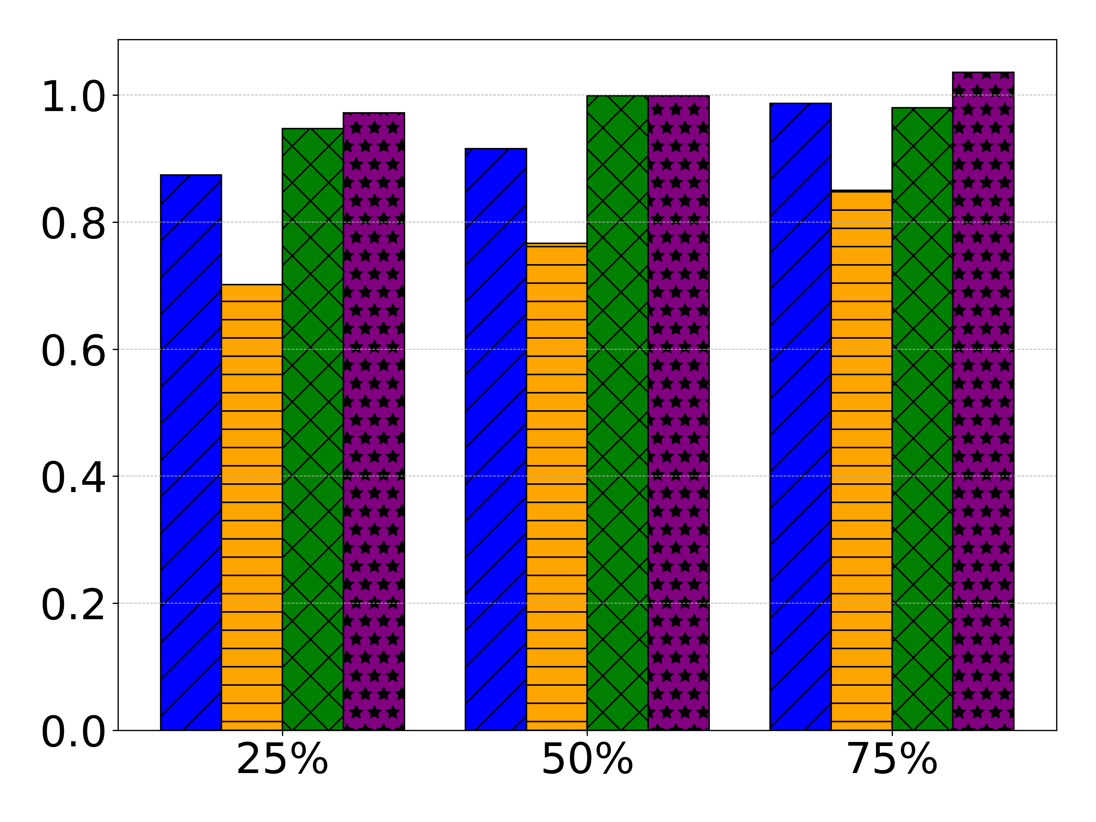
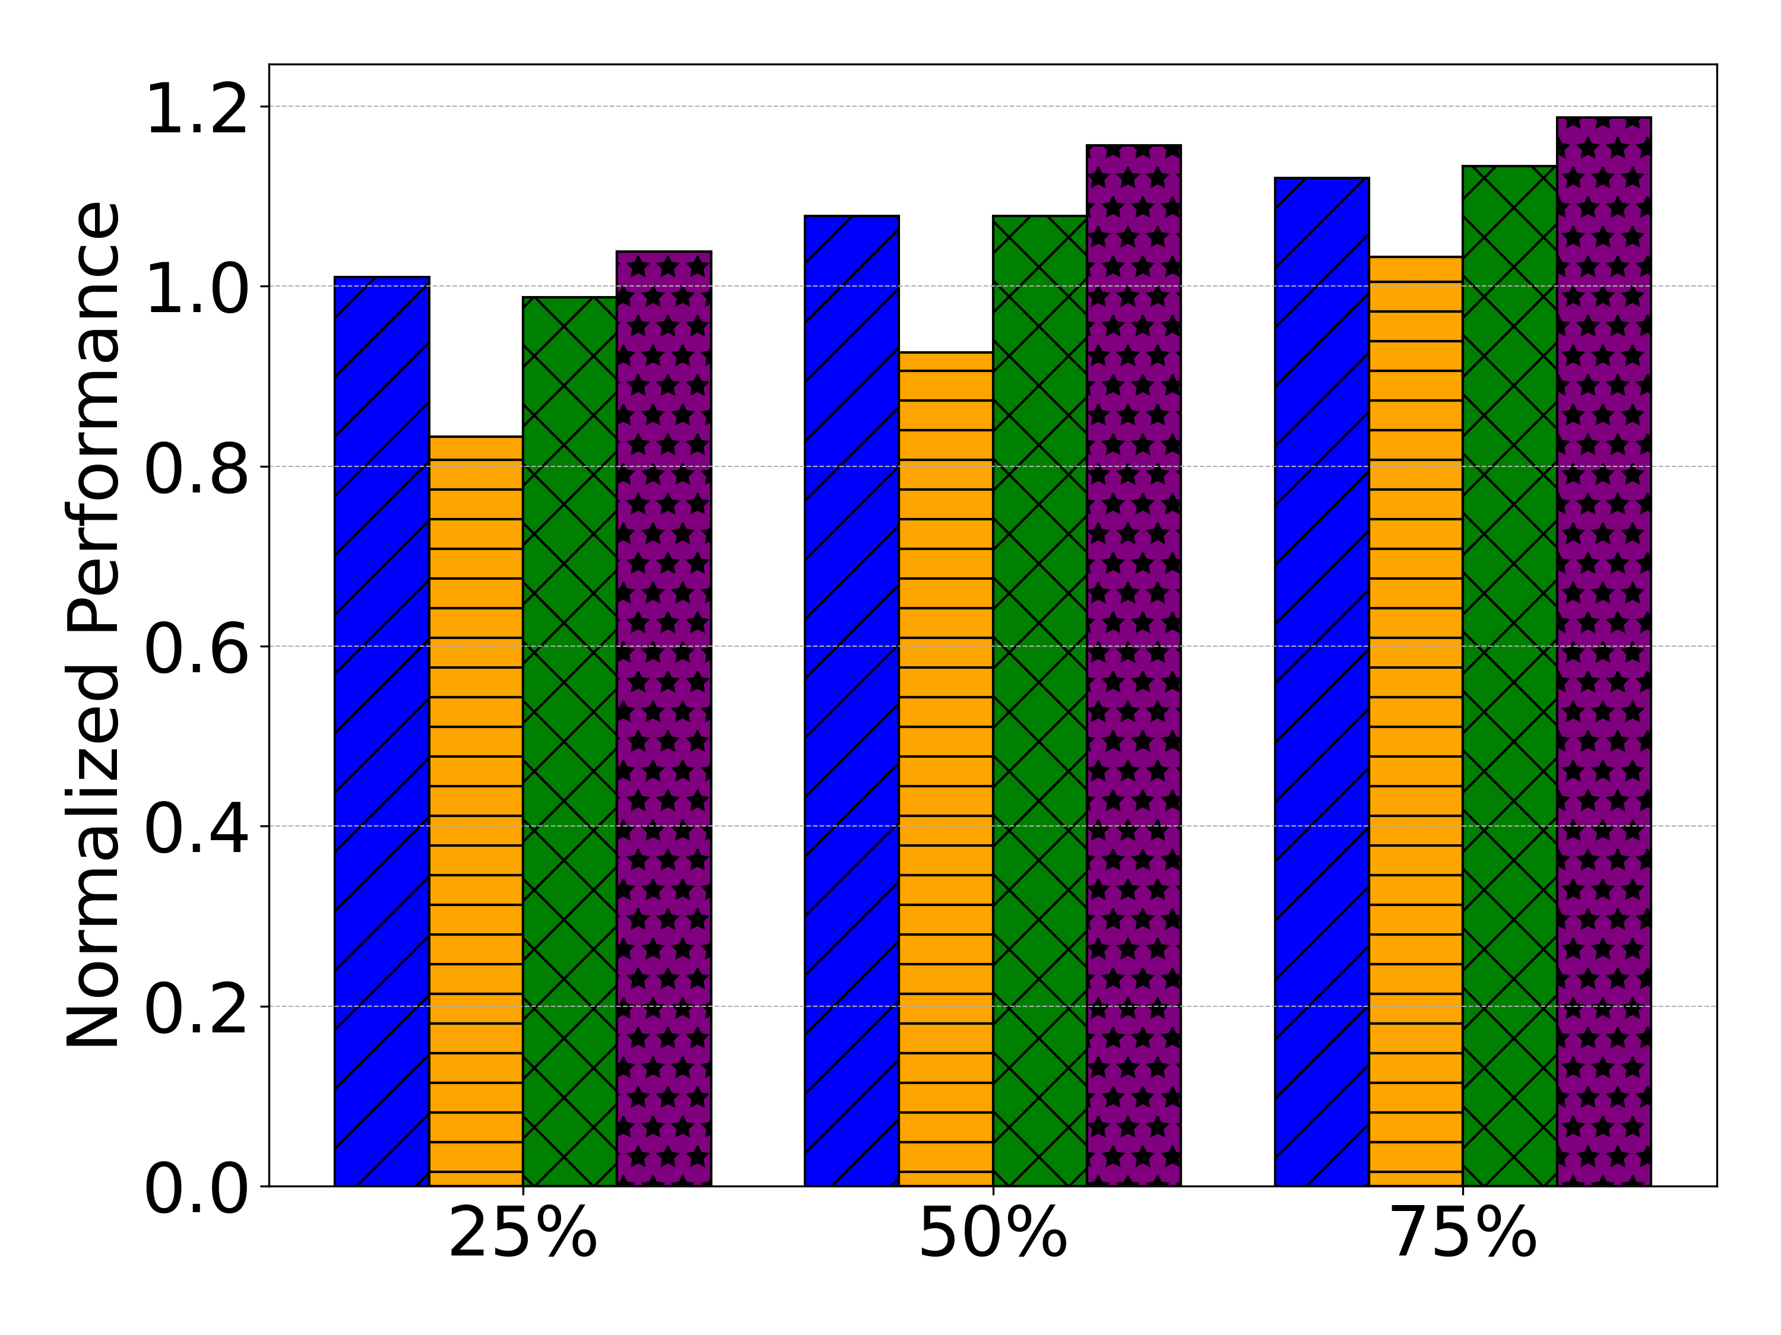
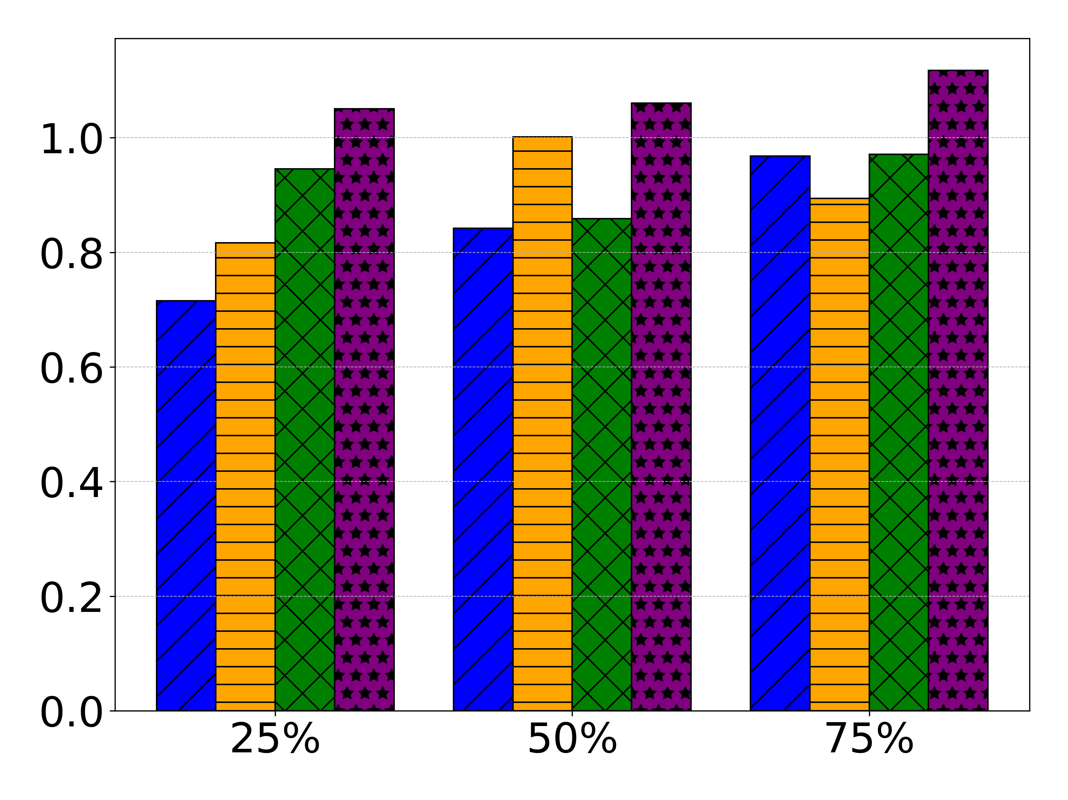




Performance
1.24x
Perf. to slow tier
Astar
Bellman
KC
LC
Astar
Across 33 comparisons, MTP outperforms TPP in 25, AutoNUMA in 30, MEMTIS in 15 cases.
Notes:
Here we show the normalized performance compared to running the workloads entirely in remote CXL, so the higher on the y-axis, the better performance.
[click]
As you can see, compared to state of the art tiering solutions TPP and MEMTIS, MTP outperforms them significantly.
[click]
For example, in Astar, under severe local memory pressure, which is 25%, MTP outperforms TPP for 1.24x.
This is due to OS’s inability to track fine-grained memory access and falsely demotes hot pages to slow tier, causing performance degradation. // remember to update this in prelim
[click]
Across 33 comparisons, MTP outperforms TPP in 25 cases, AutoNUMA in 30 cases, and MEMTIS in 15 cases.

Slide 20
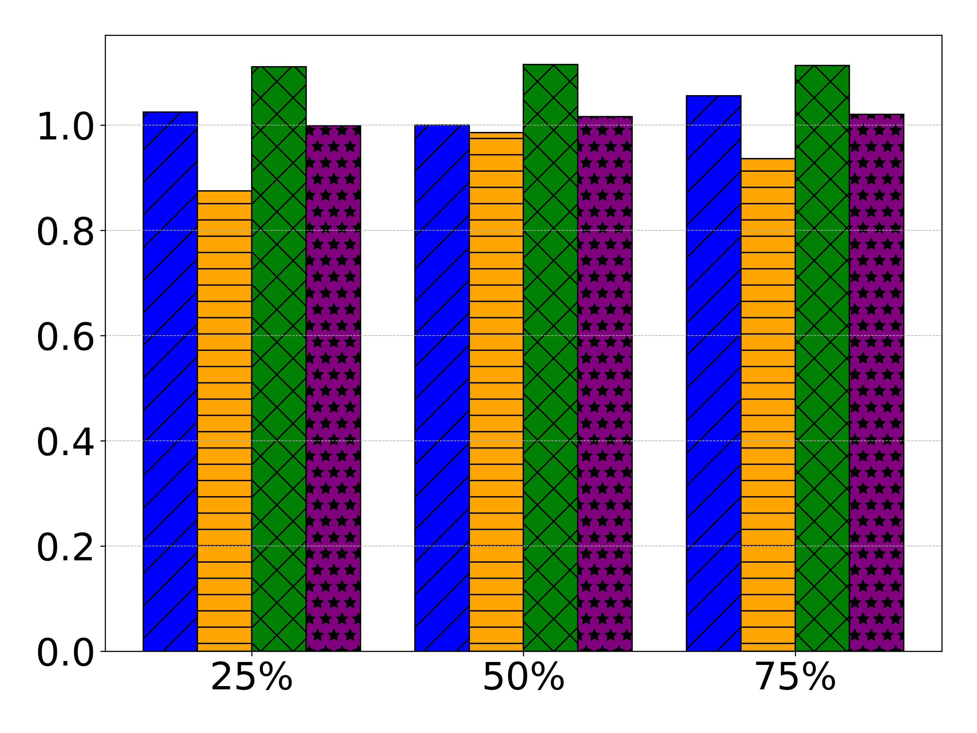
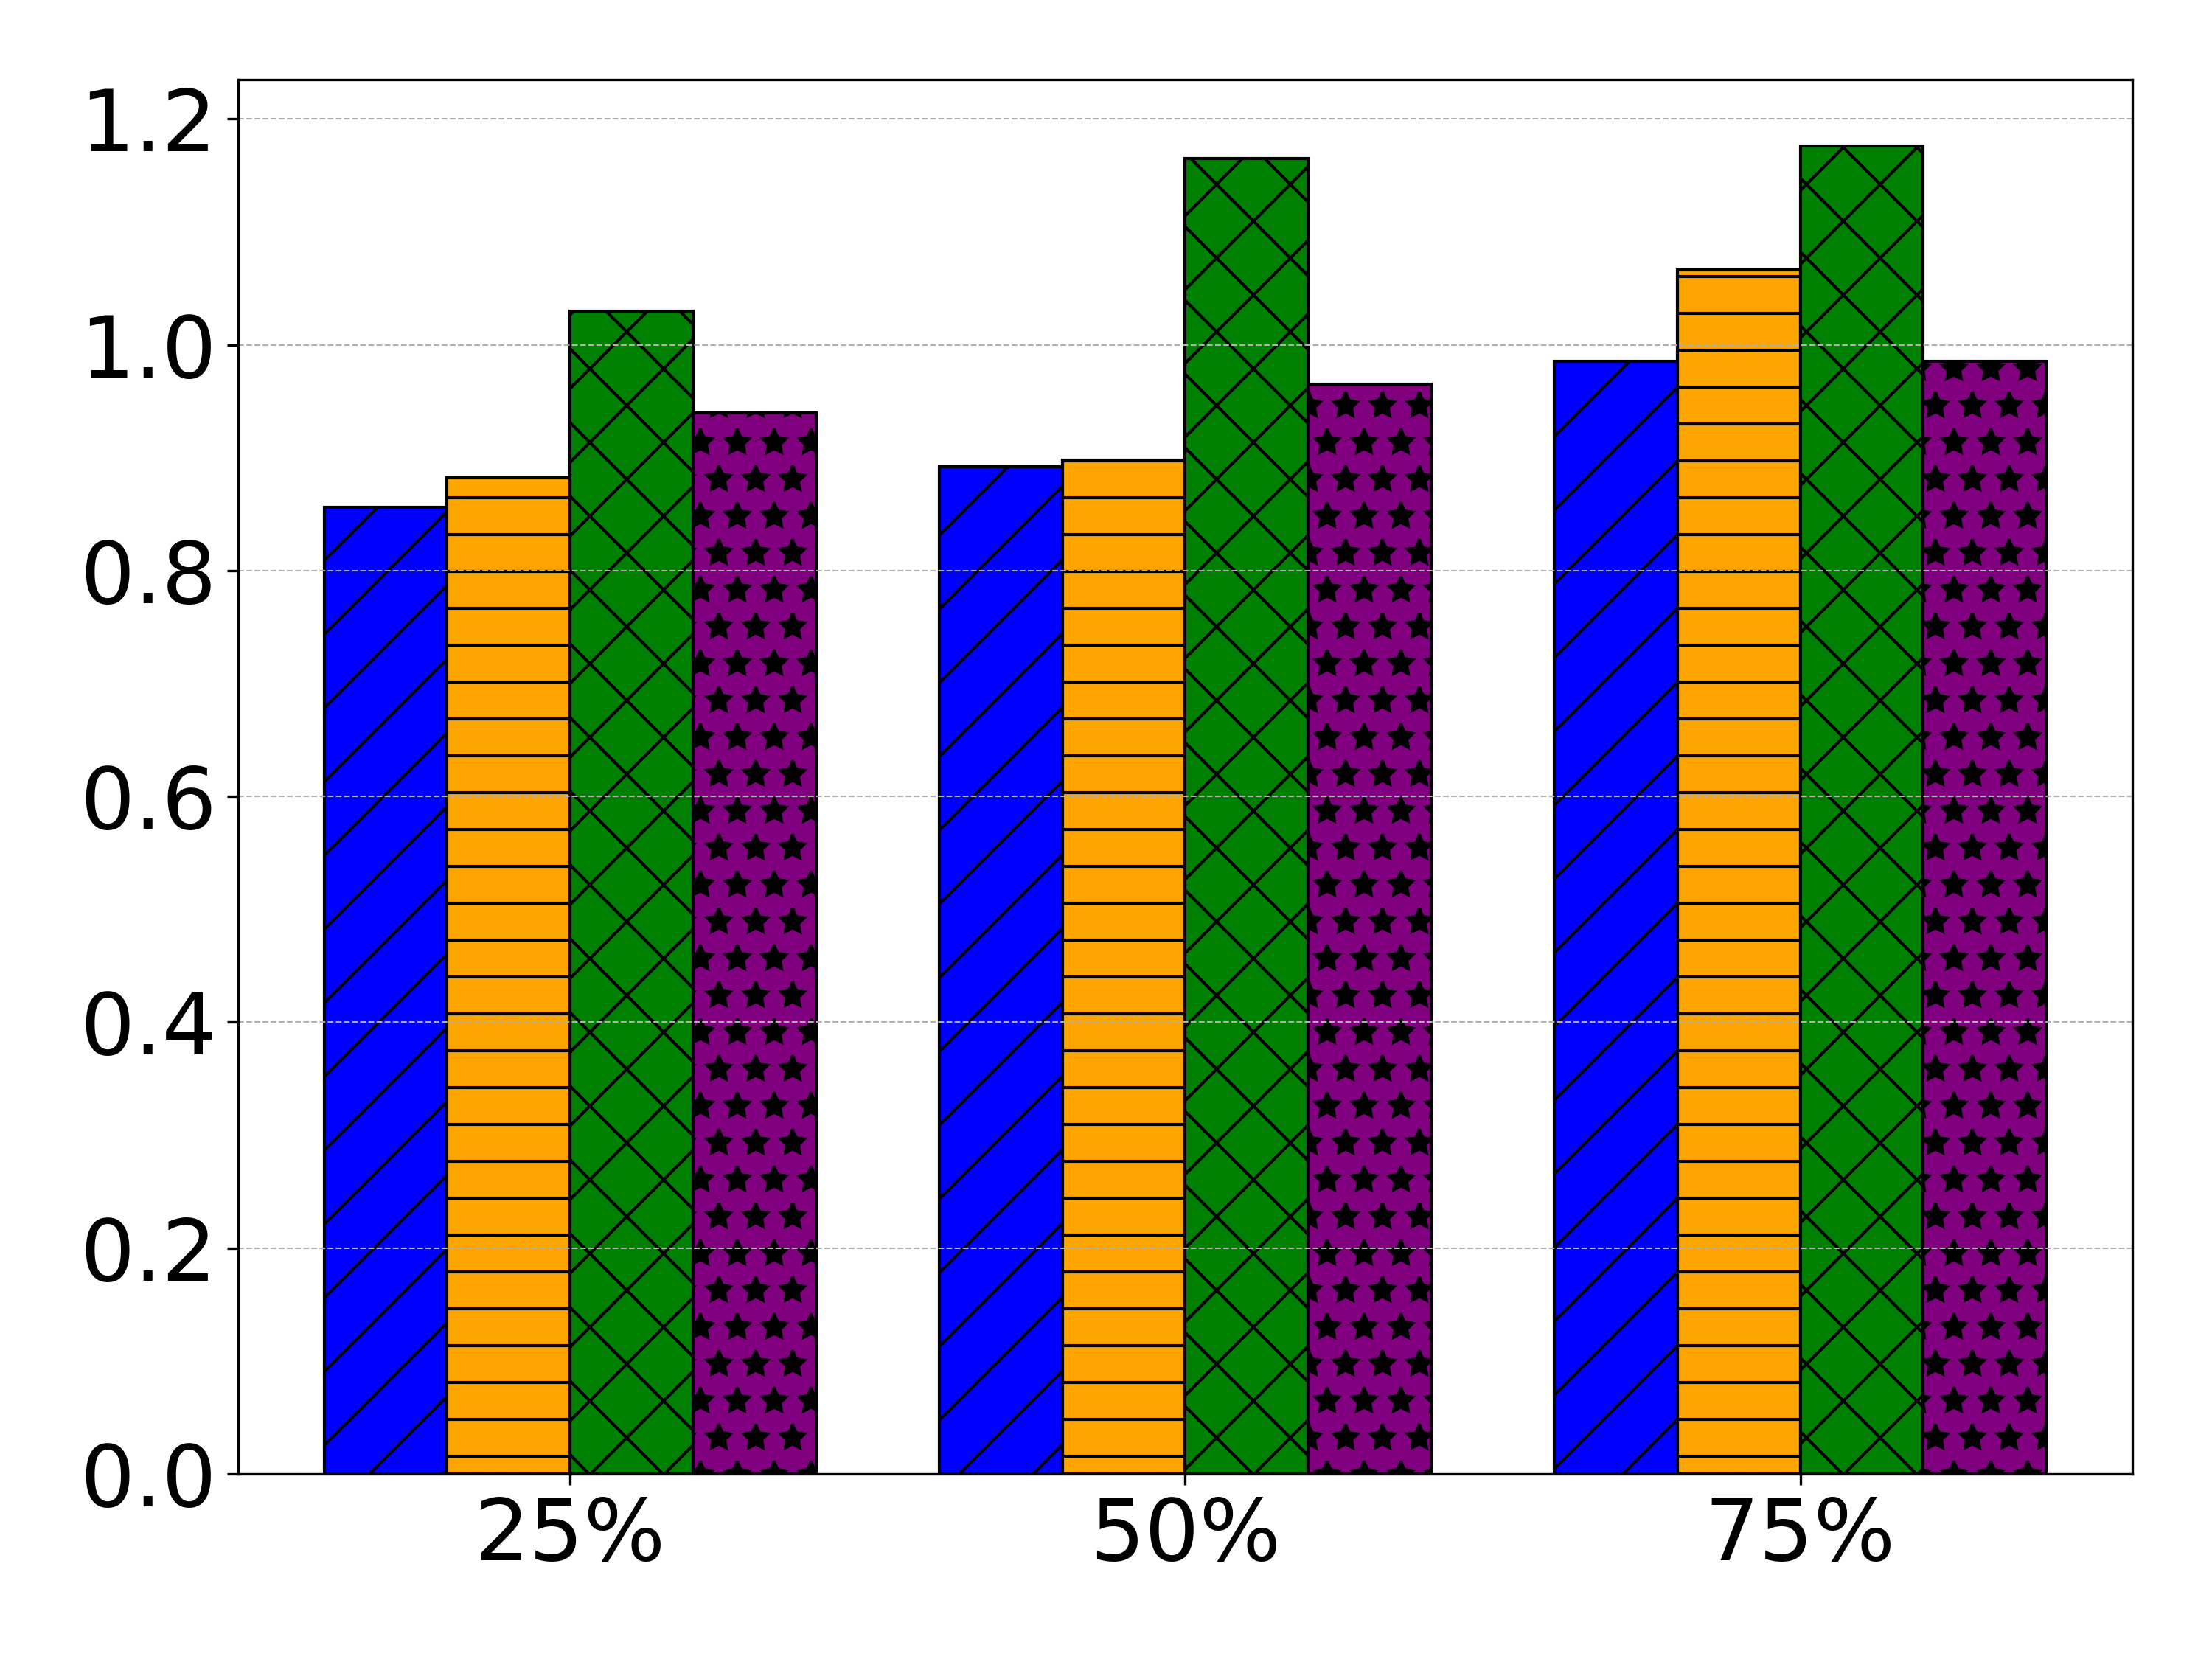
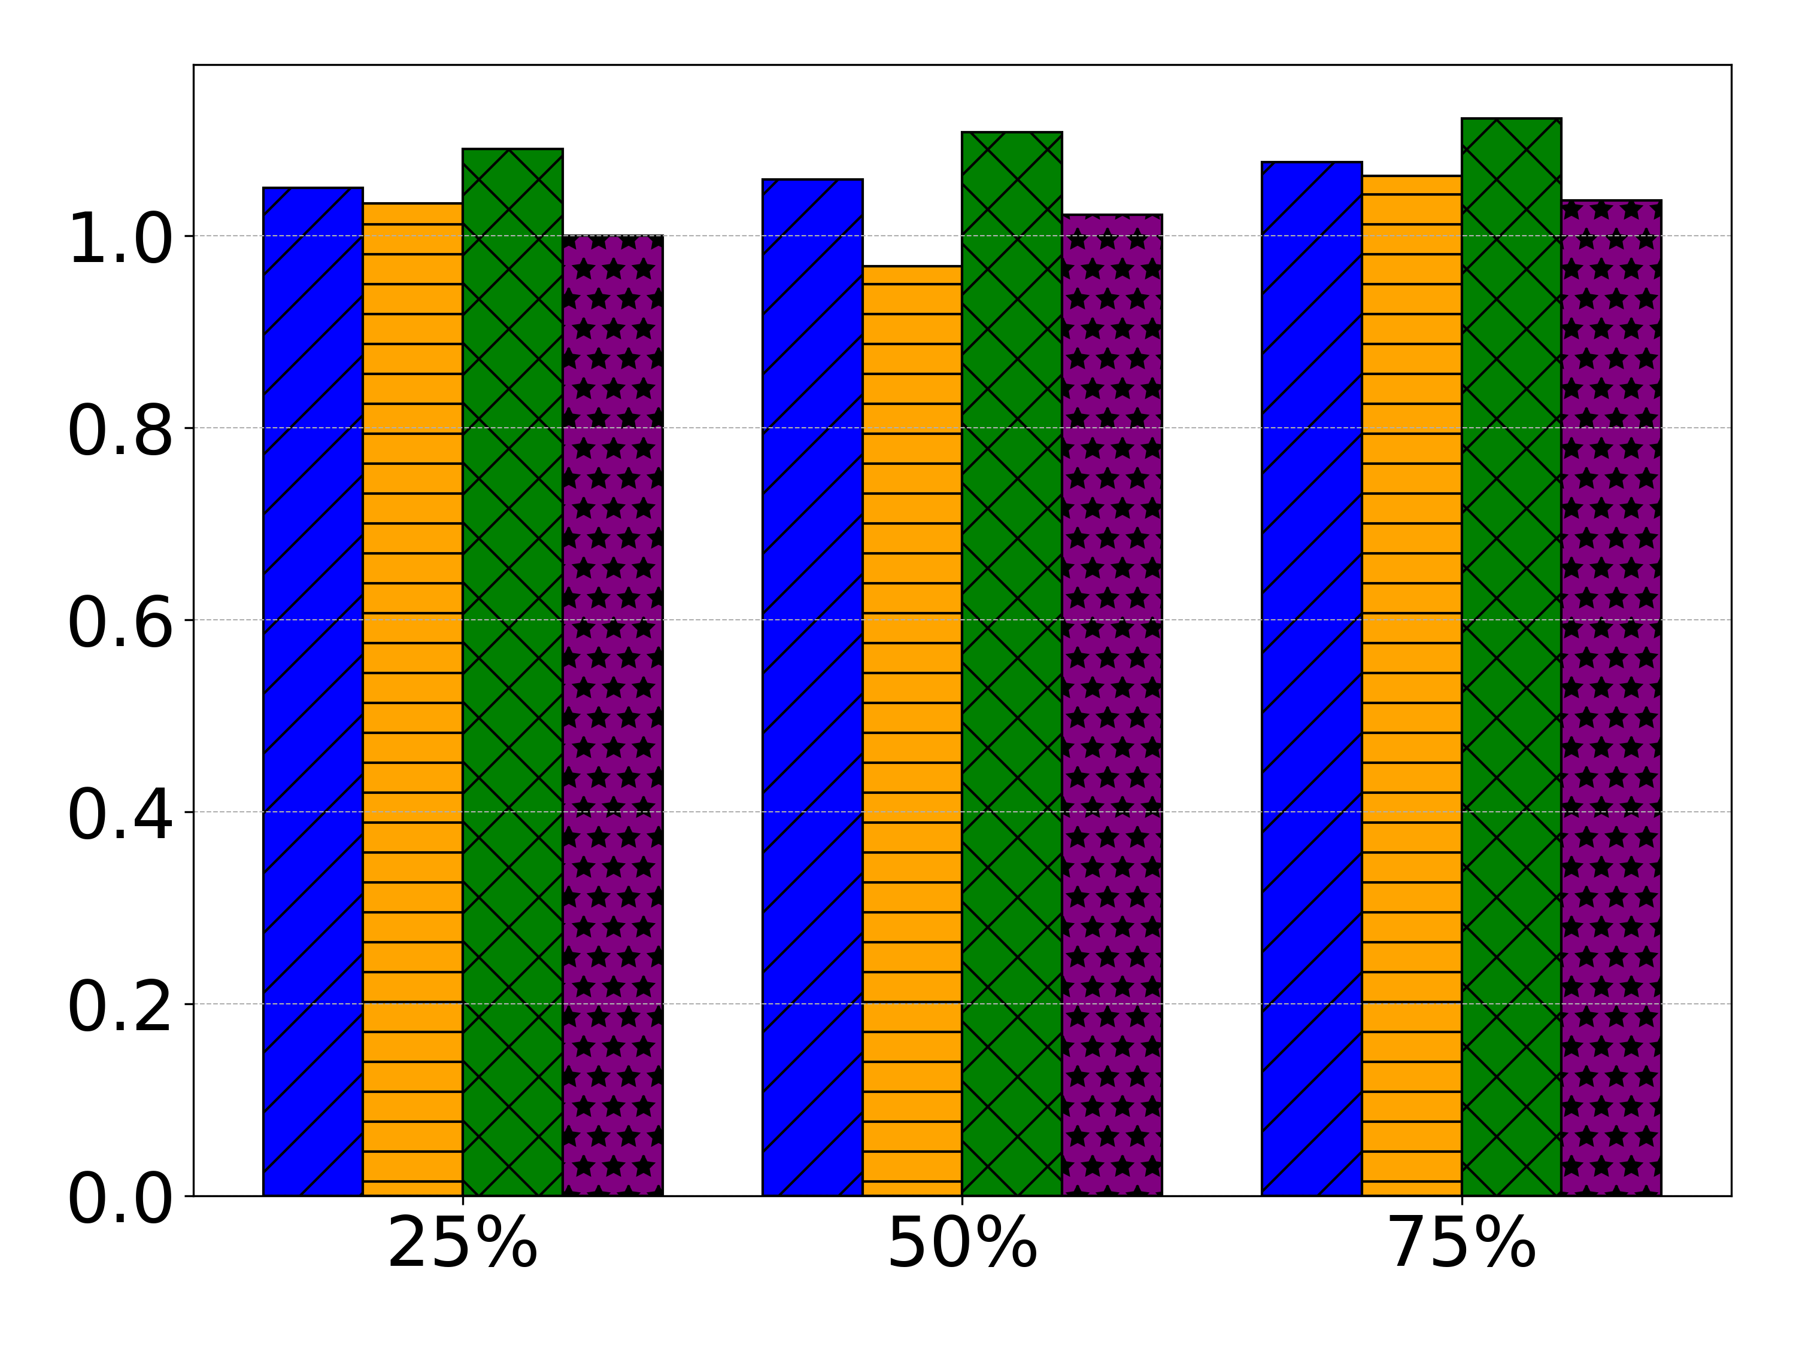
Performance
BFS_rand
SP
SQL3
Reasons for not the best:
The very first marking cannot be skipped
Bookkeeping reference count changes (mtp_cnt)
Notes:
However, we have to admit that for some workloads, MTP doesn’t always perform the best.
[click]
We identified two root causes. First, MTP spends huge amount of time doing the very first marking phase. At this time, MTP has no prior knowledge of the Python object scope, thus it needs to perform the most exhaustive marking across almost all objects. The marking time scales with the object scope. Sometimes it might overshadow the migration benefit.
[click]
The second cause is that MTP interposes the objects reference count manipulating paths. Remember we increase the value of mtp_cnt whenever an object refcnt is increased or decreased. This step in the critical path adds additional CPU overhead.

Slide 21
Summary
MTP: PL VM-integrated tiering system for Python applications
Refcnt changes -> predict hotness
Cyclic GC -> marking objects & reduce overhead
Eagerness-driven metric to determine hot/cold threshold
Comparable performance to state-of-the-art OS solutions
Simple API for customizable tiering configurations
Notes:
To summarize, in this work we propose MTP, a Cpython-intergrated memory tiering system for Python applications.
MTP infers fine-grained Python object hotness from reference count changes, without relying on OS page sampling.
It utilizes existing cyclic GC module in Python VM to mark objects and reduce unnecessary overhead.
To determine the hot/cold threshold for application itself, if utilizes an eagerness-driven metric by considering how eager pages in the slow tier wants to be promoted to fast tier
It delivers performance that is comparable or superior to state-of-the-art OS based methods, but most importantly, MTP provides customizable, per-application tiering opportunities.
This allows cloud providers to tailor memory management to the specific QoS needs of their Python applications, unlocking significant efficiency and performance gains in modern data centers.

Slide 22
Thank you!
Notes:
Thank you and I would like to take any questions

Slide 23
32 LSB for native CPython reference counting
// 8-byte, PyObject address, populated during marking
PyObject *op
uint32_t prev_growth
// 4-byte, temporarily storing the previous growth
—-----------------------------------
uint32_t ob_refcnt[0]
uint32_t mtp_refcnt[1]
—-----------------------------------
*ob_type
—-----------------------------------
… (others)
32 MSB unused by native CPython, we make this as our growth field, only increases
uint8_t changes[0]
uint8_t changes[1]
Sampling routine:
curr_growth= op->growth
changes[i] = abs(curr_growth - prev_growth)
prev_growth = curr_growth
PyObject_HEAD
…
uint8_t changes[7]
PyObject_HEAD in native CPython, interposed by MTP
Metadata layout for MTP sampling for each object
Notes:
Backup slides to show the detailed impl of MTP.
LHS: modified pyobject header -> enable capturing the changes of refcnt
RHS: metadata to record refcnt changes

Slide 24
Page Migration - Adaptive Lazy Demotion
Observation: Current cold pages may not need to be demoted, if soon become hot again.
OS-based tiering solution (TPP) uses lazy demotion (a page will be demoted only if it has been continuously identified twice as cold) -> suboptimal decision
Notes:
migration here includes both demotion and promotion

Slide 25


Page Migration - Adaptive Lazy Demotion
Workload RSS
Other programs
Other programs
(a) Small RSS_{fast}, migration -> interference ↑ -> # demotion ↓
Other programs
Other programs
(a) Large RSS_{fast}, migration -> interference ↓ -> # demotion ↑
fast local tier
slow remote tier
Notes:
migration here includes both demotion and promotion

Slide 26
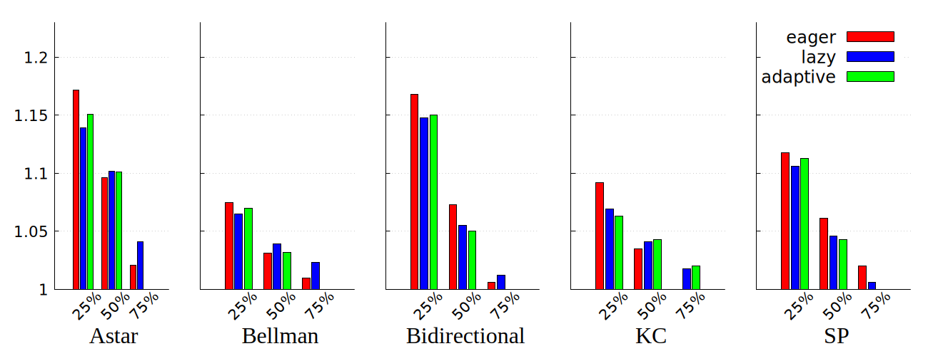

Evaluation - Adaptive Lazy Demotion

