Slide 1



Eliminate Branches by Melding IR Instructions
Yuze Li*, Srinivasan Ramachandra Sharma*, Charitha Saumya, Ali R. Butt, Kirshanthan Sundararajah
*Equal contributions
Notes:
Good afternoon everyone. THis is Yuze from Virginia Tech.
Today I am presenting our work, a compiler transformation that eliminates branches by Melding IR instructions.
This is a joint work with collaborator from Intel.

Slide 2
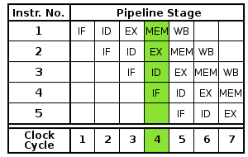






Branches Destroy Program Efficiency
High ILP ✅
Guess correct
if (X)
then
A
else
Guess wrong
  Flush pipeline
  Stall
  Re-fetch instructions
  Re-issue instructions
~18 cycles wasted^{[1]} + ILP destruction!
B
C
D
[1] Branch prediction is not a solved problem, 2019
Notes:
Modern CPUs hide latencies by keeping many instructions in flight at once.
[click]
This achieves high instruction level parallelism. On real world workloads this is one of the highest impact factors separating fast programs from slow ones.
[click]
ILP only works as long as the pipeline keeps moving forward. One thing that stops the pipeline from moving forward is control flow.
Every conditional branch is a fork in the road, and the processor cannot know which way to go until the condition is resolved.
Instead of waiting which will starve the pipeline, it guesses.
[click]
When the guess is correct, the CPU pipeline has no impact, with ILP as high as the program could achieve.
[click]
However, when guess is wrong, the processor has to flush the speculative work, throw away the in-flight instructions, restart fetching from the correct path, and re-issue them.
[click]
The misprediction penalty not only waste cycles, but also destroys the ILP the pipeline had built up. On x86, the combined penalty is around 18 cycles per misprediction.
[click]
and in production environment, this creates high performance loss.

Slide 3
Existing Methods
Hardware: Branch predictor
TAGE-SC-L^{[1]} predictors reach 97% accuracy
Failure on data-dependent branches (hash probing, graph traversal, etc), with mem access
Software: if-conversion
Branched code -> straight-line code
Branched code
Straight-line code
if (X)
A
A
then
else
compute B
B
C
compute C
if-conversion
X ? B : C
D
D
[1] Tage-sc-l branch predictors again, JWAC-5, 2016
Notes:
To mitigate this, existing hardware method uses branch predictors. Modern predictors like TAGE-SC-L reach 97% accuracy on average. Most of the time, this works.
[click]
The problem is the 3% that remains. Those failures are not random, they are concentrated on data-dependent branches, such as hash-table probes, graph traversals, often comes with a lot memory accesses.
For these branches, there is no history to learn from: each outcome is determined by the input data itself.
[click]
Another complementary method is on the software side. People have been thinking: if there is no branch, there is no guess it could go wrong, right?
This technique is called if-conversion.
Here, the compiler takes an if-then-else branch code, pre-executes on both sides as straight-line code, and selects the result at the end, based on the condition.

Slide 4
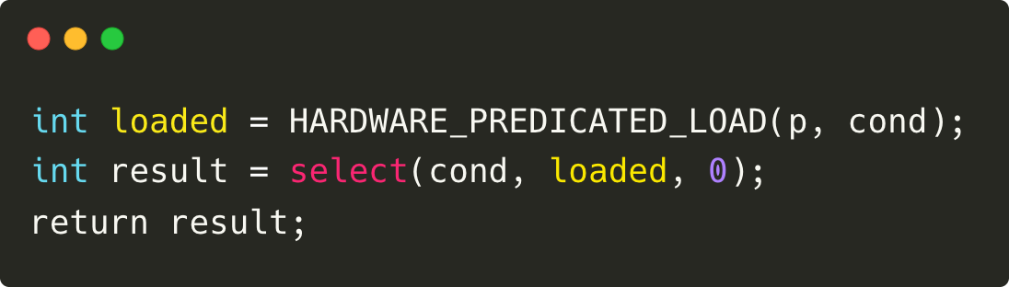
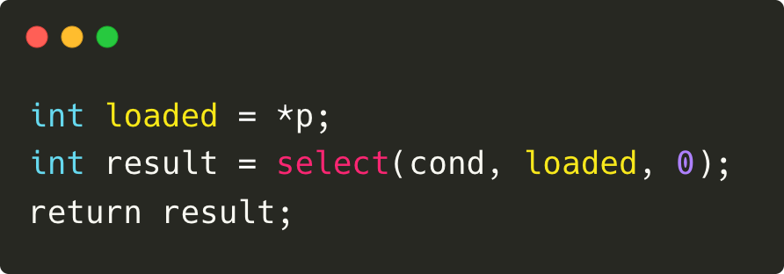
Existing Methods
Hardware: Branch predictor
Memory predication: ld/st is issued unconditionally and the hw will handle (nullify) any unexpected behavior
Software: if-conversion
Branched code -> straight-line code
Architecture-dependent
ISA supports memory predication (AArch32)
// governed by hw predicates ✅
…
cond ? loaded : 0
ISA lacks memory predication (x86, AArch64)
…
Problem: if-conversion skips any branch block that has memory operations, high mispredictions hurt ILP!
Straight-line code
// faults if p invalid ❌
Notes:
However, software if-conversion has its own limitation, it is architecture dependent.
[click]
Take a look at this example, where a branched code is compiled by if-conversion into straight-line code. The results will be chosen from either the value “loaded “or “0”
[click]
For architecture that supports memory predication, this transformation can be performed.
[click]
Here, hardware memory predication means a load or store is issued unconditionally and the hw architecture will handle any unexpected behavior.
In this example, the loaded value is unknown until runtime. The hw will govern even if this memory load is invalid. It will nullify the operation on the silicon board.
[click]
However, for ISA that lacks memory predicates, this straightline code could potentially fault during runtime memory access.
[click]
Hence, if-conversion refuses to touch any branch code that contains memory operations. This means that, it gives up on exactly those highly mispredicted branches that hurts ILP. This is the gap this work focuses on.
Ok a side question is that, why do modern architectures no longer supports memory predication?
The fundamental reason is that modern architectures support Out-of-order execution rather than in-order. Issuing memory predications will waste the issue slots and physical registers on the silicon.
// side note below if further questions
Intel's APX essentially acknowledges this retrospectively. As out-of-order CPUs continue to become deeper and wider, the cost of mispredictions increasingly dominates the performance of such workloads. Branch predictor improvements can mitigate this only to a limited extent as data-dependent branches are fundamentally hard to predict Intel. They're adding conditional loads and stores back to x86 — after decades without them — because the tail case has become important enough to justify the encoding cost. Y

Slide 5

Compilation Stages
target-independent
target-dependent
C
x86
Front-end
LLVM IR
C++
ARM
Middle-end
Back-end
RISC-V
Go
If-conversion
PowerPC
Rust
Intuition: Lift branch elimination from target-dependent back-end, to target-independent middle-end
Notes:
In a typical compilation pipeline, frontend takes source code from different languages, and compiles them into IR.
Then, the middle-end performs several optimizations, before handling over to the back-end,
[click]
on the back-end, it performs architectural-specific code generations and optimizations.
[click]
This is where existing if-conversion performs.
[click]
Our intuition is simple, instead of doing the if-conversion in late back-end, why don’t we lift it to the middle-end. Because here any optimizations are target-independent. So the software strategy for eliminating branches can work on any hardware.

Slide 6
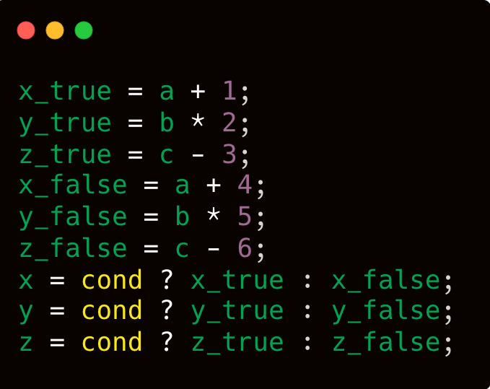
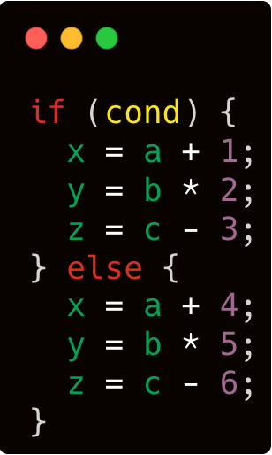
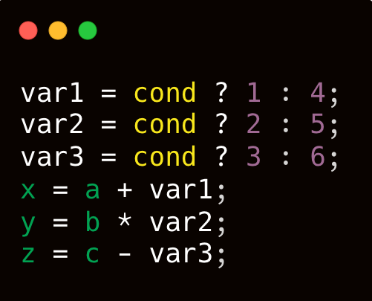
Melding IR Instructions (MERIT)
Observation: divergent control-flow paths perform structurally similar operations, differing primarily in their operands.
6 instructions
3 selects
Structurally similar
Transformed by if-conversion
Meld!
3 selects (same)
Native branch-ed code
3 instructions
Transformed by MERIT
Notes:
We present MERIT, melding IR instructions, an architecture agnostic transformation sitting in the middle-end.
[click]
We observe that, divergent control-flow paths often perform structurally similar operations differing primarily in their operands.
[click]
Given this branch block with an if else statement, each with three instructions doing calculations on variables x, y, and z.
[click]*2
The traditional If-conversion would speculate on each entire body,
[click]
that’s 6 arithmetic instructions
[click]
followed by three selects to choose the speculated results.
[click]
On the contrary, instead of speculating on both paths naively, MERIT transformation will first analyze the structural similarities from both paths. In this case, it will find 3 pairs of similar instructions occur for x, y and z.
[click]
Then, it would meld each pair of instructions into just one, arithmetic operation. Notice that here because we know the program semantics in LLVM-IR, it finds out that the only difference is the constant operand added to variable a, which is either 1 or 4.
Thus, it will select on 1 or 4 based on the condition. and store the result into variable 1.
[click]*2
Similar melding happens to variable 2 and 3.
[click]
At last, it only needs to do 3 arithmetic operations to compute x, y, and z.
[click]
In total, we need 3 selects, but we effectively cut down the arithmetic instructions from 6 to 3, because of instruction melding.

Slide 7

Identifying Similar Instructions
Branch block instructions
DNA sequences
analogous
A T C G A A C T G G C C
. . | | . | | | | |
T A C G C A C T - - C C
if (%cmp)
add %0, %1
-
sdiv %5,%4
-
store
|
.
.
.
|
else
add %0, %2
load %3
-
add
store
Smith Waterman Algorithm, 1981
add %0, %1
%merged1 = select %cmp, %1, %2
Aligned instructions:
Merged addition:
add %0, %2
%res1 = add %0, %merged1
Divisor selection:
sdiv %5, %4
sdiv %5, %4
%merged2 = select %cmp, %4, 1
Unaligned instructions:
Merged division:
-
sdiv %5, 1
%res2 = sdiv %5, %merged2
Insert extraneous instr on the other path
Notes:
To align instructions from both paths, we borrow the idea from the smith waterman algorithm, originally proposed to find local optimal DNA sequence alignment.
[click]
Similarly, we walk through both branch paths to find paired operations.
[click]
In this example, the first add, and the last store instructions can be perfectly aligned. For them, we first select different operands, followed by a single computation, as I showed in last slide.
[click]
For unaligned instructions, for example, the division here,
[click]
we first make them aligned by inserting an extraneous, but the same instruction on the other path, in this case, the same sdiv, with the divisor as 1
[click]
Then, we first select from the different operand, either %4, or 1,
[click]
And finally we do a merged division.

Slide 8
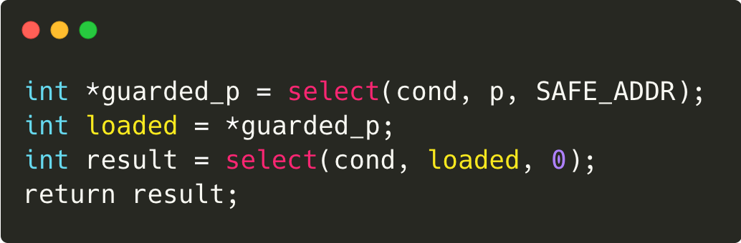
Software Memory Predication
%safe_addr is a compiler-inserted (dummy) safe address, never alias with any original program's memory
Address selection:
-
load %safe_addr
%merged3 = select %cmp, %safe_addr, %3
Memory instr:
Merged load:
load %3
load %3
%4 = load, * %merged3
w/o software predication (broken ❌)
w/ software predication (safe ✅)
// unconditionally, may fault
// sw memory predication
// always safe
*Note: The loaded dummy data finally get discarded (mimicking what hw does in sw).
Notes:
Now the problem comes to handling memory instructions, remember, if a memory instruction becomes unconditionally executed due to branch elimination. It would fault on hardware that lacks the predication support.
[click]
To solve that, we use the compiler to prepare a safe address. This address is zero-initialzed by the compiler and we make sure it doesn't overlap or aliases with any of the original program's memory.
[click]
Whenever we need to insert a memory load instruction, we directly select from that dummy address.
[click]
Then we directly perform the merged memory load instruction, based on whichever the address we just selected.
[click]
So comparing with the code that would have causing fault on hw due to lack of predication,
[click]
Now with MERIT’s software memory predication, we use the safe_addr to redirect the memory loading, so it will always be safe.
// [click]
// One thing to note here is that, loading from the dummy value does NOT break the program semantics. Because if the condition is false, the loaded value will be discarded anyway. What we’re essentially doing is, achieving branch elimination by mimicking what hw predicates does in the sw.
// int result = 0;
if (cond) {
result = *p;
}
return result;

Slide 9

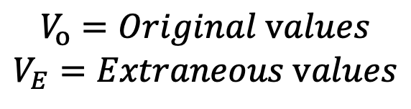





Semantic Preservation
$$V_{o}=Original values$$
$$V_{E}=Extraneous values$$
$$∀u∈V_{o}:deps∗(u)∩V_{E}=∅$$
Extraneous values never interfere with original values!
Real pipeline
Dummy pipeline
$${Instr}_{1}$$
$$V_{o}$$
$$V_{E}$$
$${Instr}_{2}$$
$$V_{o}$$
$$V_{E}$$
discarded
select
Notes:
Because we are inserting extraneous instructions and computing on both paths, a critical question is: how do we guarantee those extraneous instructions don’t poison the real program data?
[click]
MERIT enforces strict data flow isolation. Let’s define Vo as the original program values, Ve as extraneous dummy values we insert.
[click]
MERIT transformation guarantees that: the transitive dependencies of any original values, will never intersect with the extraneous values.
// u is any single value that belongs to the set Vo
[click]
Intuitively, we create two isolated data flow pipelines. Any extraneous dummy values we generate only feeds into extraneous instructions. They run along the side of the real pipeline until both path hit the final select statement, which we safely discard the dummy values at the end

Slide 10
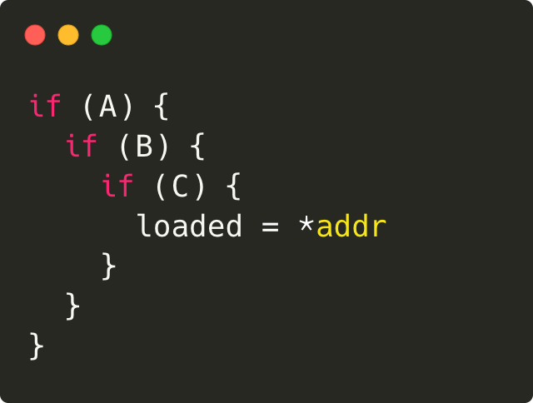
Fixed-point Iteration
A
A
A
c1=select(%C, addr, SAFE)
T
T
F
F
T
F
B
B
b1=select(%B, c1, SAFE)
T
F
T
F
c1=select(%C, addr, SAFE)
C
a1=select(%A, b1, SAFE)
F
c1=select(%C, addr, SAFE)
b1=select(%B, c1, SAFE)
T
loaded = *a1
loaded = *addr;
loaded = *c1
loaded = *b1
Notes:
MERIT performs fixed-point iteration, that means, it repeatedly applies on all branch blocks from the inner most one, all the way to the outer most.
Let’s take a look at a branched code. If and only if all 3 conditions, A, B, and C are met, will the memory load be executed.
Down below shows the control flow graph of it. If any condition is false, it directly jumps to the fallthrough path.
[click]
In the 1st iteration, MERIT eliminates branch C and transforms into straight-line code, like this
[click]
Then it eliminates branch B, turning it into a select.
[click]
Finally, all 3 conditions are converted to straight-line select statements followed by just a single load.
This algorithm is guaranteed to terminate. Every successful merge strictly decreases the total number of eligible branch diamonds.
// We eliminate the control flow step-by-step until the code reaches a fully straight-line fixed point.

Slide 11
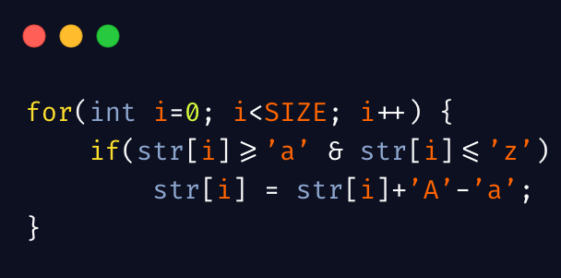
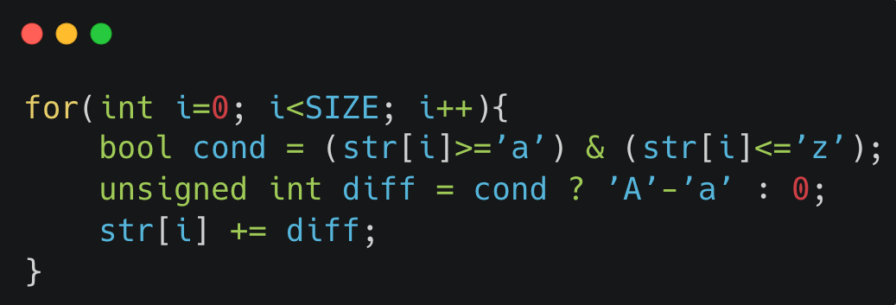
To_upper
Branched code
MERIT transformed
Highly mispredicted ❌
No mispredictions (32x) ✅
+ later optimizations (48x)
Notes:
Here we give a to_upper program that converts smaller cases to upper cases one by one in a given string.
[click]
In the naïve branch code, since it contains memory instructions, if-conversion cannot perform, experiencing high mispredictions.
[click]
However, in MERIT transformed code, after inserting extraneous instructions and merging, it’s able to convert this block into straight-line code.
[click]
Because MERIT safely guards the memory access through software memory predication, we completely eliminate the misprediction, unlocking 32x speedup.
[click]
Better yet, converting this to straight-line code unlocks downstream auto-vectorization, pushing the gains to 48x.

Slide 12
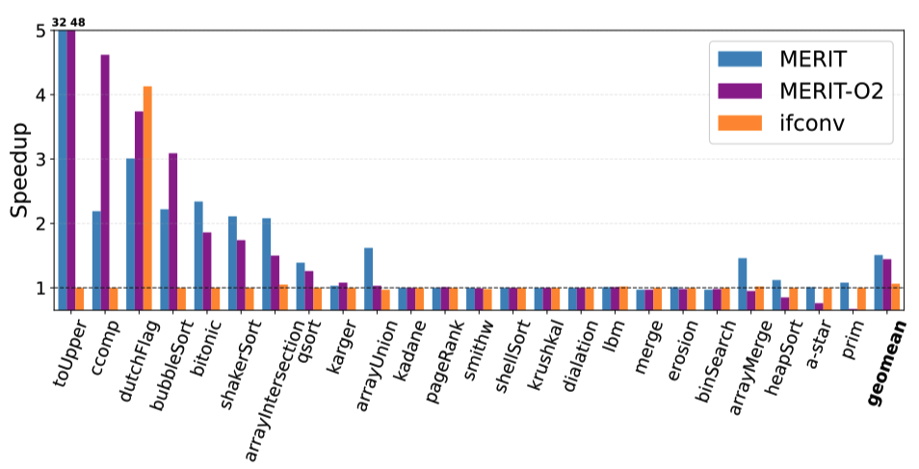
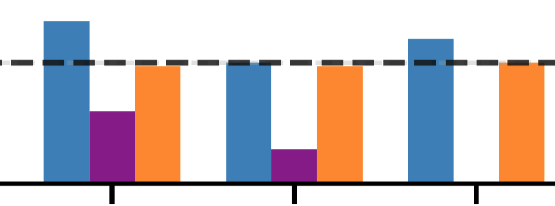
Microbenchmarks
Backend interference!
MERIT: 1.52 (eliminates branch misprediction)
if-conversion:1.06
MERIT-O2: 1.42 (with backend interference on certain kernels)
Un-do MERIT: Sees transformed code as expensive and convert back to multiple branches.
Blow up code size: Unrolling larger loop bodies destroys I_{cache}.
x86, Ice lake, 22.04
Notes:
Coming to the evaluation. Let's first look at some branch-heavy microbenchmarks.
The blue bars, which are MERIT compiled, achieve a geomean speedup of 1.52x compared to the baseline hardware branch prediction.
These microbenchmarks are dominated by highly mispredicted, data-dependent branches. And MERIT completely eliminates them.
Traditional if-conversion, which are orange bars, can only get 1.06x performance.
[click]
However, when we enable standard optimizations O2, it turns out that not all backend optimizations favor MERIT.
Because we operate in the middle-end, the downstream LLVM passes are completely unaware of what we did. They will apply their standard cost heuristics, and fight against our optimizations.
We identified at least 2 ways:
[click]
First, it reverts our work: The backend would see our select chains, judge them as 'expensive,' and literally convert them back into multiple branches. Those result in more mispredictions.
[click]
Second, It blow up code size: Because MERIT merges paths, our loop bodies naturally get physically larger. The loop unroller would blindly unroll them anyway, destroying our instruction cache.
The backend passes aren't broken, they just lack the context to know why we created those select chains.
// [click]
// It panicked the register allocator: Keeping variables from both the true and false paths alive at the same time artificially spiked register pressure. The allocator would panic and spill registers, killing the performance.

Slide 13
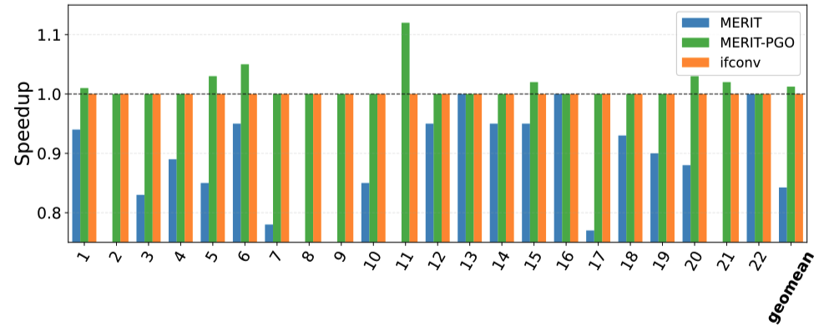
SQLite (TPC-H)
MERIT: 0.85 (blindly transform all branches)
if-conversion: 1 (no transformation)
MERIT-PGO: 1.02 (transform functions with unpredictable branches)
Notes:
We then compile SQLite with MERIT and run TPC-H analytical workload.
When we blindly apply MERIT to all branches in the SQLite engine, performance hurts. We suffered an avg 15% slowdown in the blue bars.
Why? Because in a massive codebase, not every branch is a bottleneck. Forcing a highly predictable branch into a select-chain just forces the CPU to execute unnecessary instructions. MERIT would also make some conditional memory instructions execute unconditionally, leading to extra memory pressure.
[click]
Because almost all branch codes contain memory instructions, if-conversion cannot transform them, giving performance identical to baseline hardware branch prediction.
[click]
We can apply MERIT in a Profile-Guided fashion. Here, we target ONLY the truly unpredictable branches, we can erase the slowdown and actually get some speedups, with the PGO

Slide 14
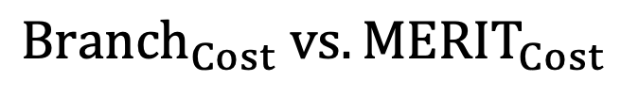
Future Work: Cost Model
$${Branch}_{Cost} vs. {MERIT}_{Cost}$$
Static tier: Statically compare branch code cost vs. post-MERIT cost
PGO tier: Calibrate branch code cost with offline profiled data
Online tier: For input-dependent branches, emit both MERIT and branch code. Hot-swapping by adapting runtime input pattern.
Notes:
This brings us to future work.
We need a cost model to compare the branch cost versus the post merit transformation cost, such as ALU, memory instructions, dependency chain. We only want to eliminate the branch when MERIT cost is lower.
We will do it in a tiered way. In the static tier, we con'servatively estimate the static cost of both sides.
[click]
If offline profiling is available, we calibrate the branch cost with offline profiled data
[click]
In the third tier, if branch behavior is input-dependent, we generate both MERIT transformed and the original branch code, waiting for online decision to hot-swap between them.

Slide 15
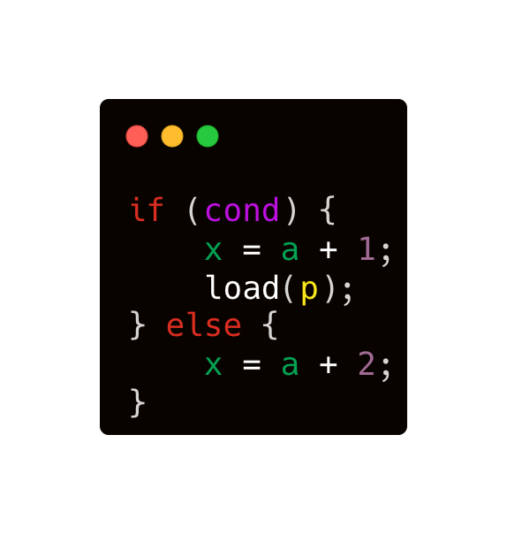
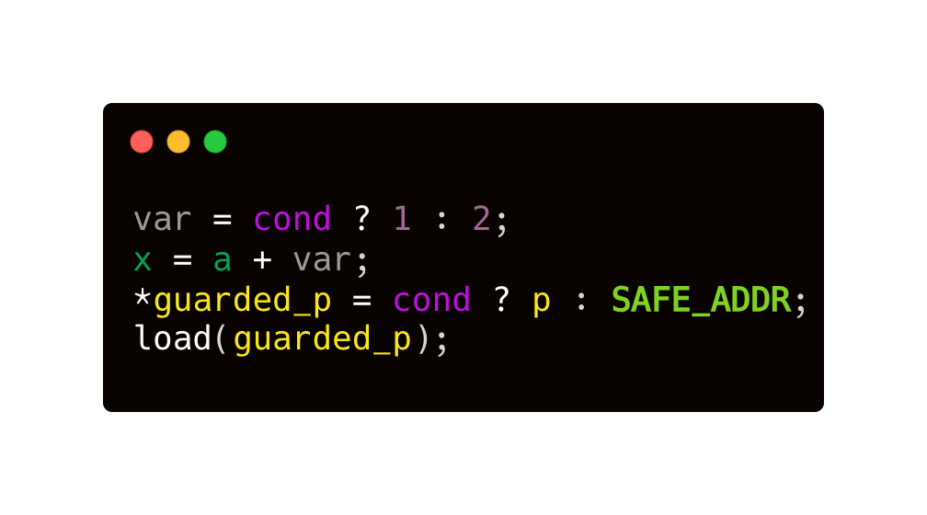




Eliminate Branches by Melding IR Instructions
Branched code
MERIT-transformed code
Paper
Artifact
Notes:
To conclude: data-dependent branches with memory operations are a major bottleneck that traditional if-conversion cannot safely handle.
[click]
In this work, we propose MERIT that eliminates branches in the middle end. MERIT analyzes the instruction similarities, selects different operand based on the condition, and performs a merged instruction.
[click]
MERIT uses software memory predication to eliminate branches that have memory instructions.
[click]
However, our work reveals that, early-stage branch elimination is powerful, but it requires intelligent cost-models and backend-coordination to reach its full potential.
Our artifacts are open-sourced, and I am happy to take any questions.

Slide 16
MERIT PGO
Granularity
File-level
Function level
Line-level
func | Branch code | MERIT code | Transform?
foo | 10ms | 12ms | ❌
bar | 8ms | 9ms | ❌
baz | 14ms | 9ms | ✅
Filtering mechanism (flags)
-<exclude>/<include>-file-names=utils.c
-<exclude>/<include>-func-names=foo
-<exclude>/<include>-lines=profile.json
Notes:
That is a great question. We built an intuitive filtering infrastructure in our LLVM pass.
We require profiling both the original branched code and the MERIT code. This tells us exactly which functions, or even while lines of code, are suffering the overhead
And we only transform those ones that can benefit from branch elimination.
Currently in the implementation, we support file, function, and line-level filtering granularity.
And we port several flags to easily exclude or include them in the deployment phase.

Slide 17
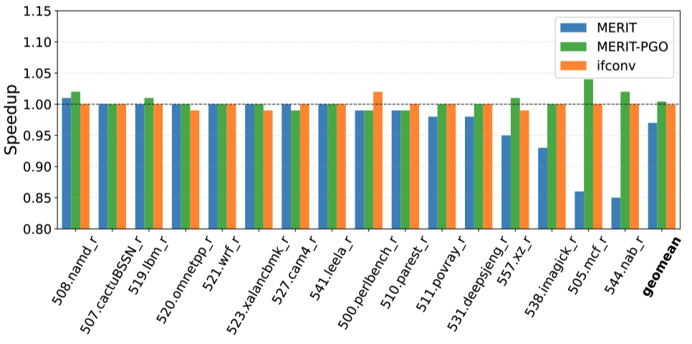
SPEC 2017
MERIT: 0.97
MERIT-PGO: 1.01
if-conversion: 1
Notes:
Audience Perspective: "If naive application causes code bloat or register spills, how do I actually use this in production without ruining my fast code?" Where to put it: When introducing the SPEC 2017 results (Slide 11). What to talk about: The paper emphasizes that blindly applying MERIT to every single branch is a bad idea. The overhead of executing extraneous instructions can easily outweigh the penalty of a highly predictable branch. Instead of relying purely on a static structural filter, you introduced PGO to selectively target only the branches that are actually mispredicting and hurting performance. Speaker Note Idea: "MERIT is a powerful hammer, but not everything is a nail. On complex workloads like SPEC2017, blindly eliminating every branch actually hurt performance. To bridge the gap between theory and reality, we integrated MERIT with PGO, allowing developers to surgically apply this transformation only where empirical data proves it's needed.”
Speaker Note: Slide 11 (SPEC 2017)
"Moving to our SPEC 2017 results, we see that MERIT is a powerful hammer, but not everything is a nail.
As the blue bars show, blindly eliminating every single branch actually hurts performance. The overhead of executing extraneous instructions easily outweighs the benefit on branches that are already highly predictable.
This raises the question: how do we actually use this in production without ruining our fast code?
To bridge the gap between theory and reality, we integrated MERIT with Profile-Guided Optimization, shown by the green bars. Instead of relying purely on a static structural filter, PGO allows developers to surgically apply this transformation only where empirical data proves a branch is actually mispredicting and hurting performance. As you can see, this completely erases the slowdowns and delivers a net positive speedup."

Slide 18
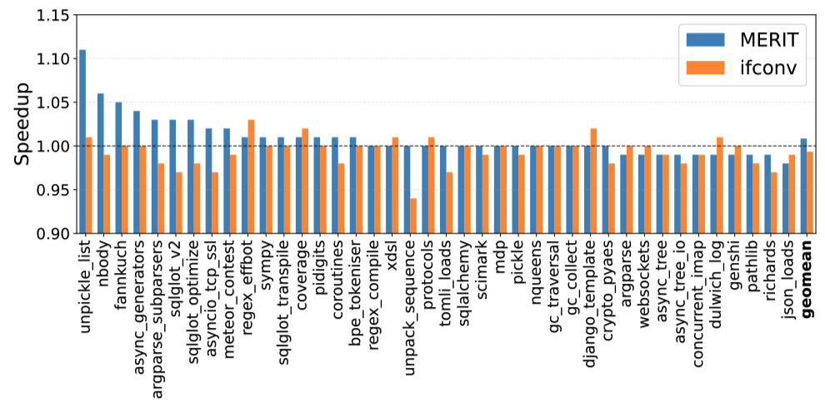
Python (Pyperformance)
MERIT: 1
if-conversion: 0.99

